Slide 1
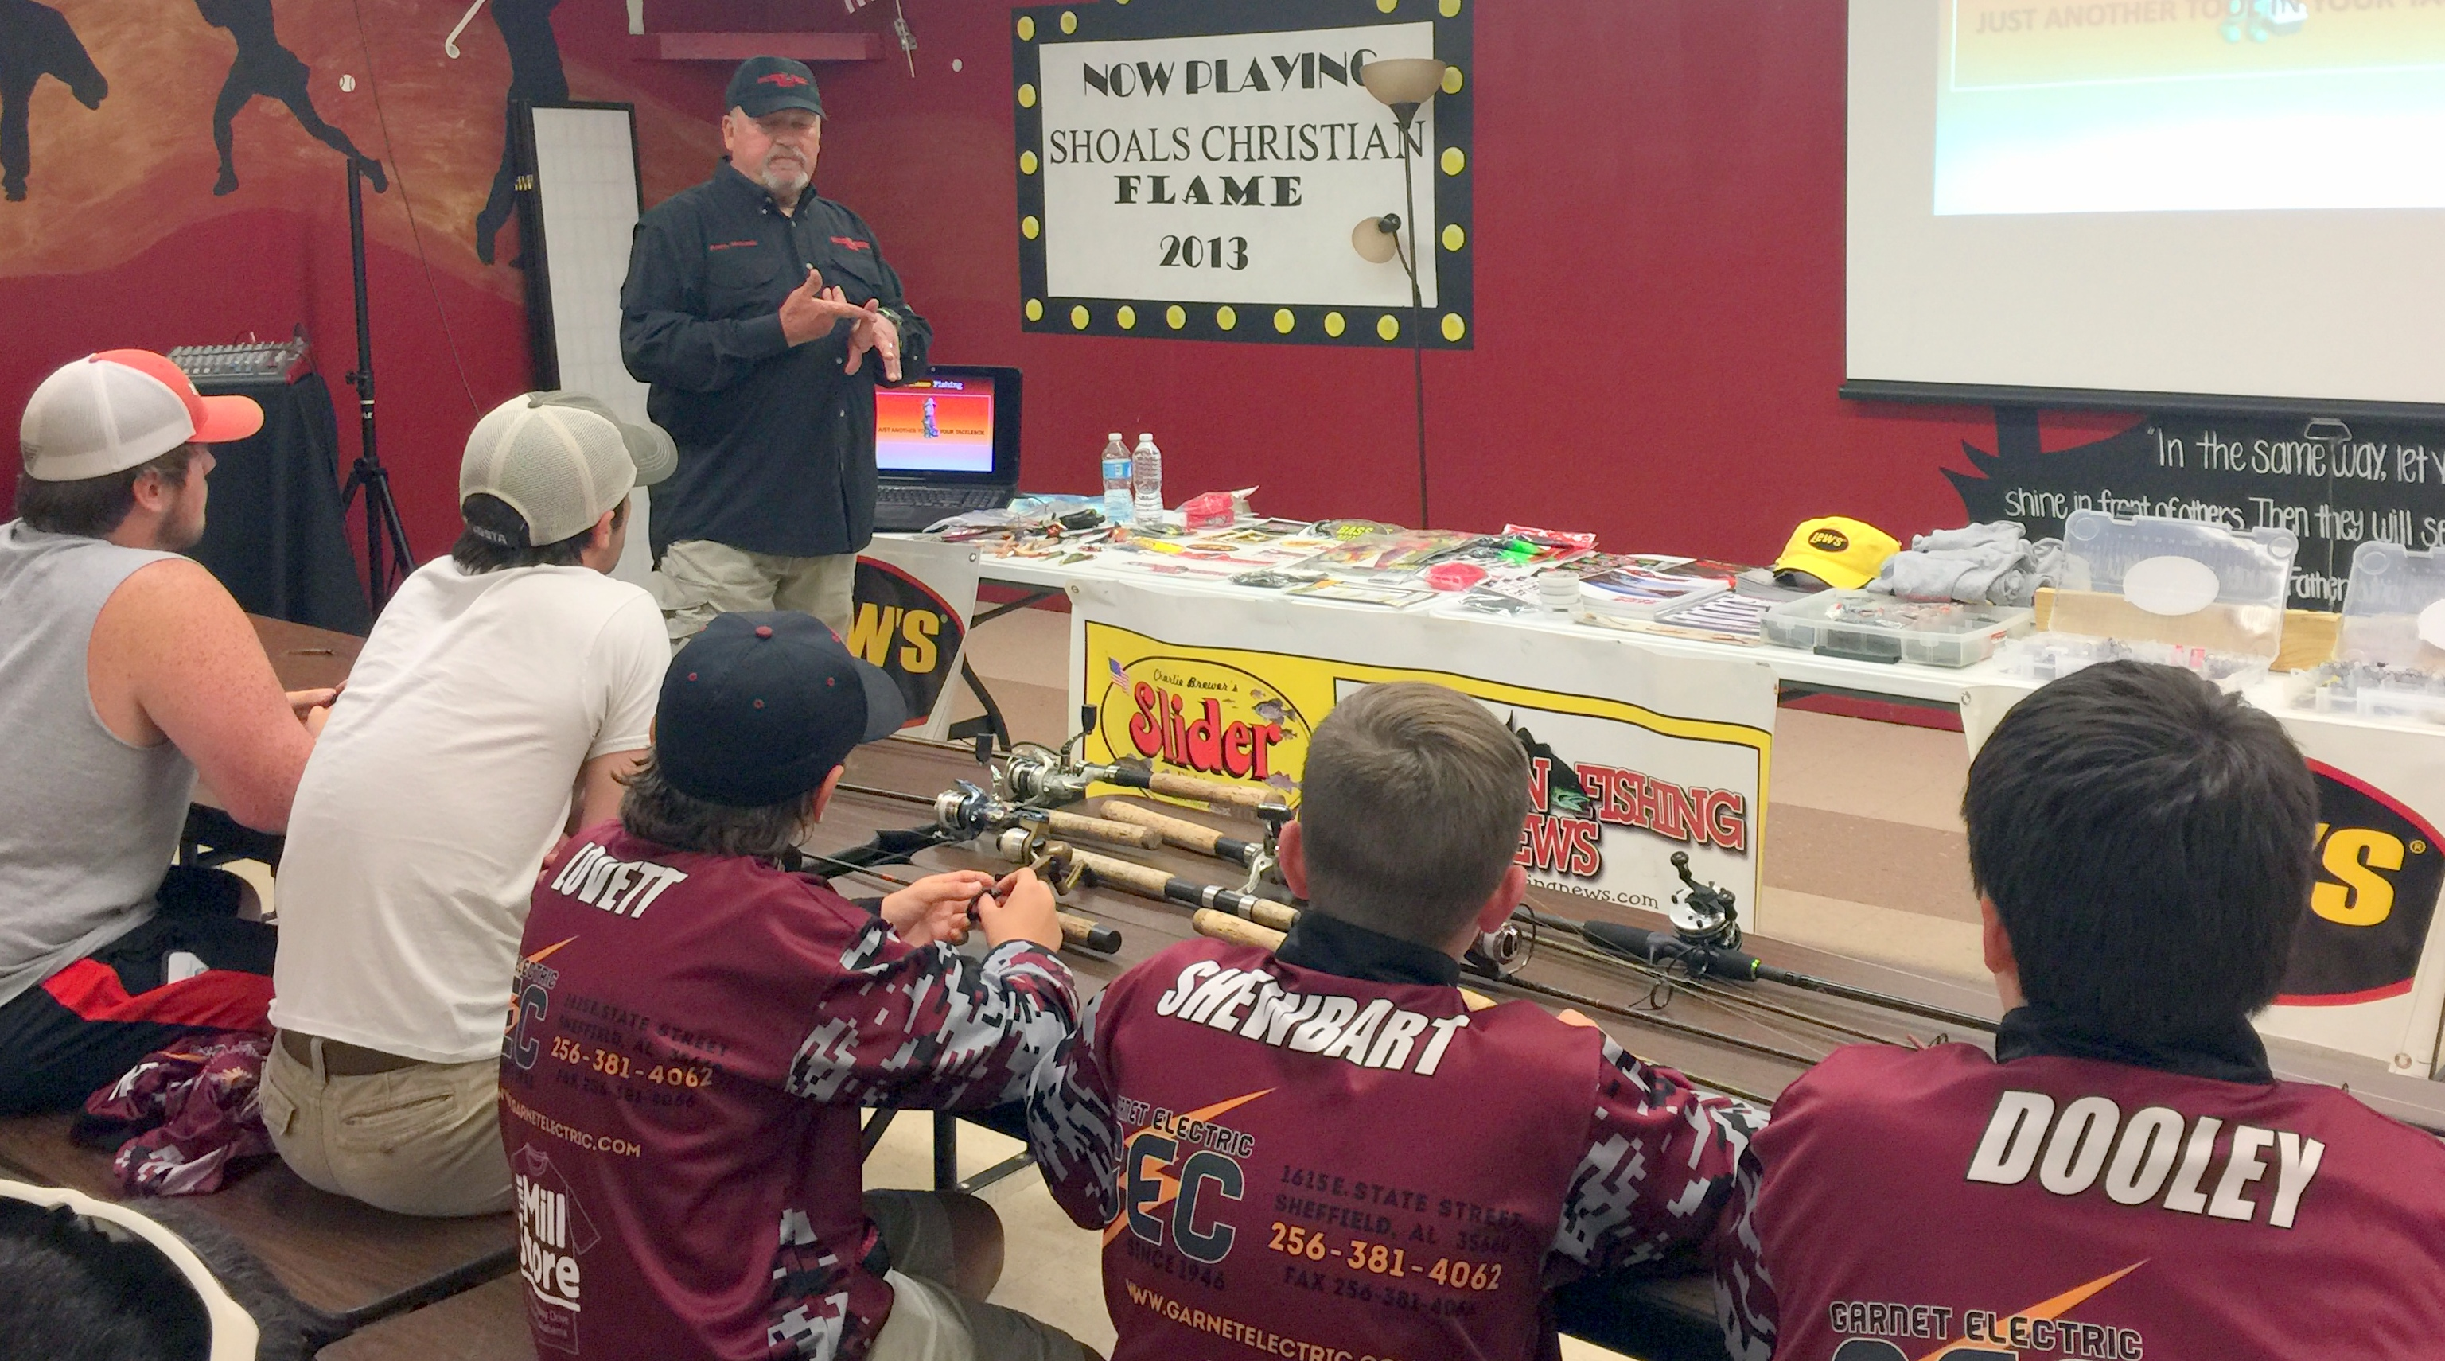
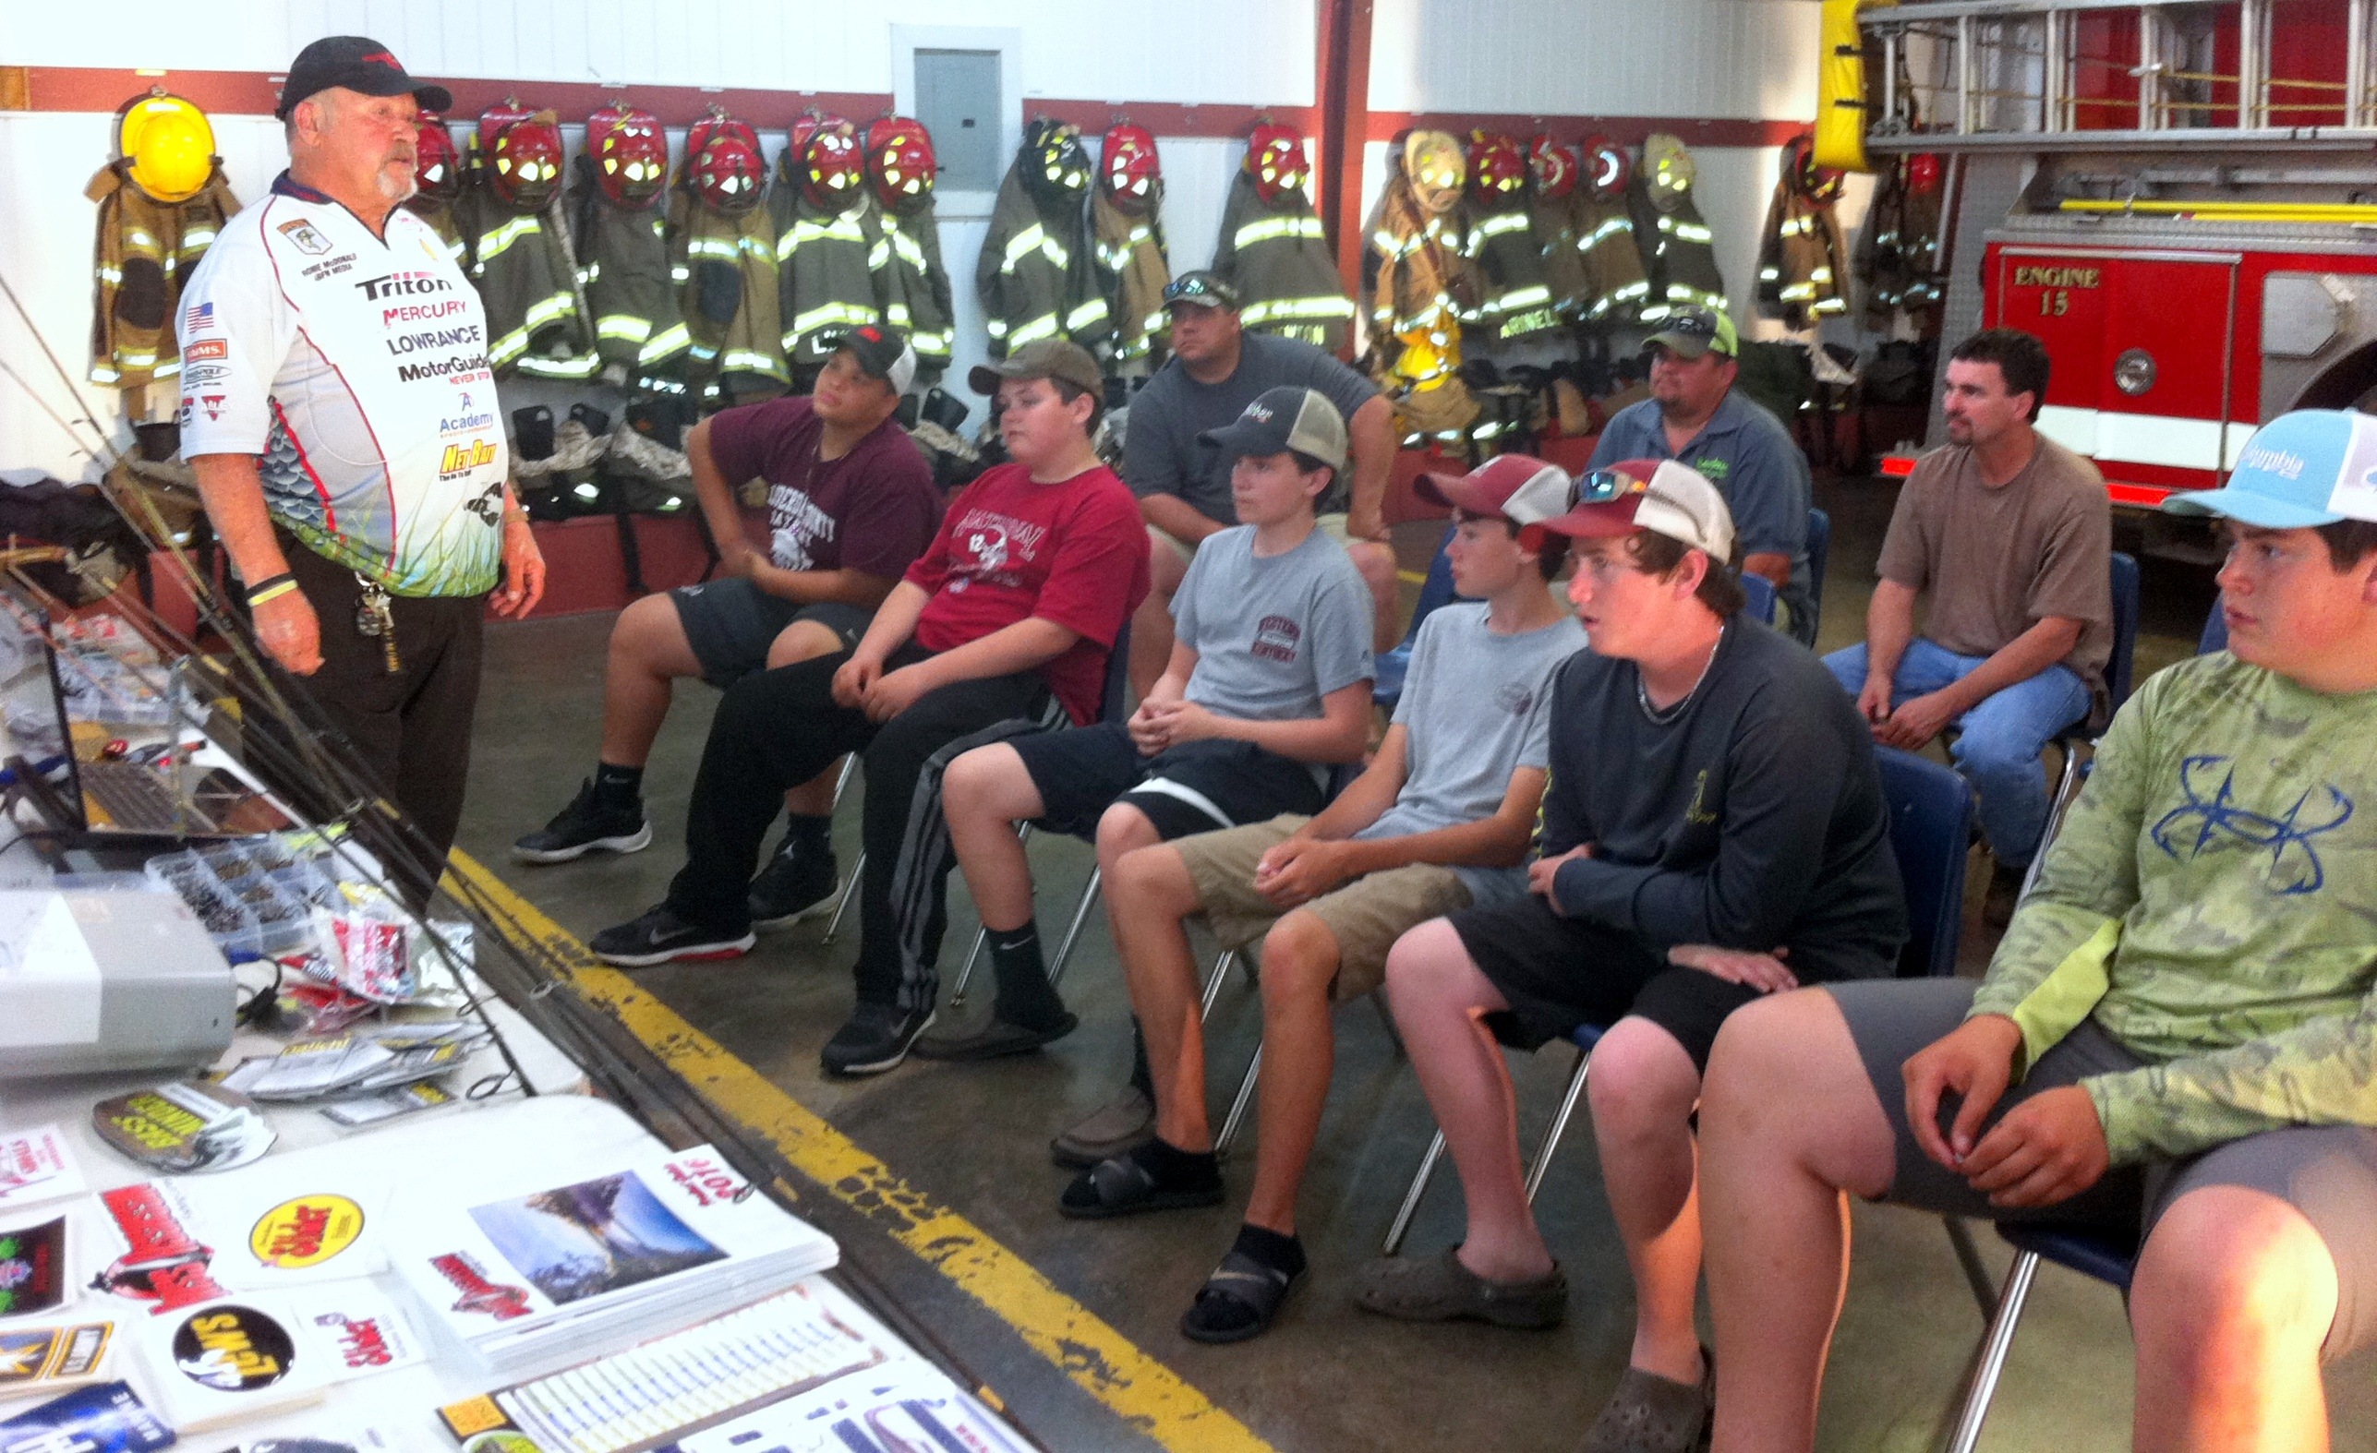
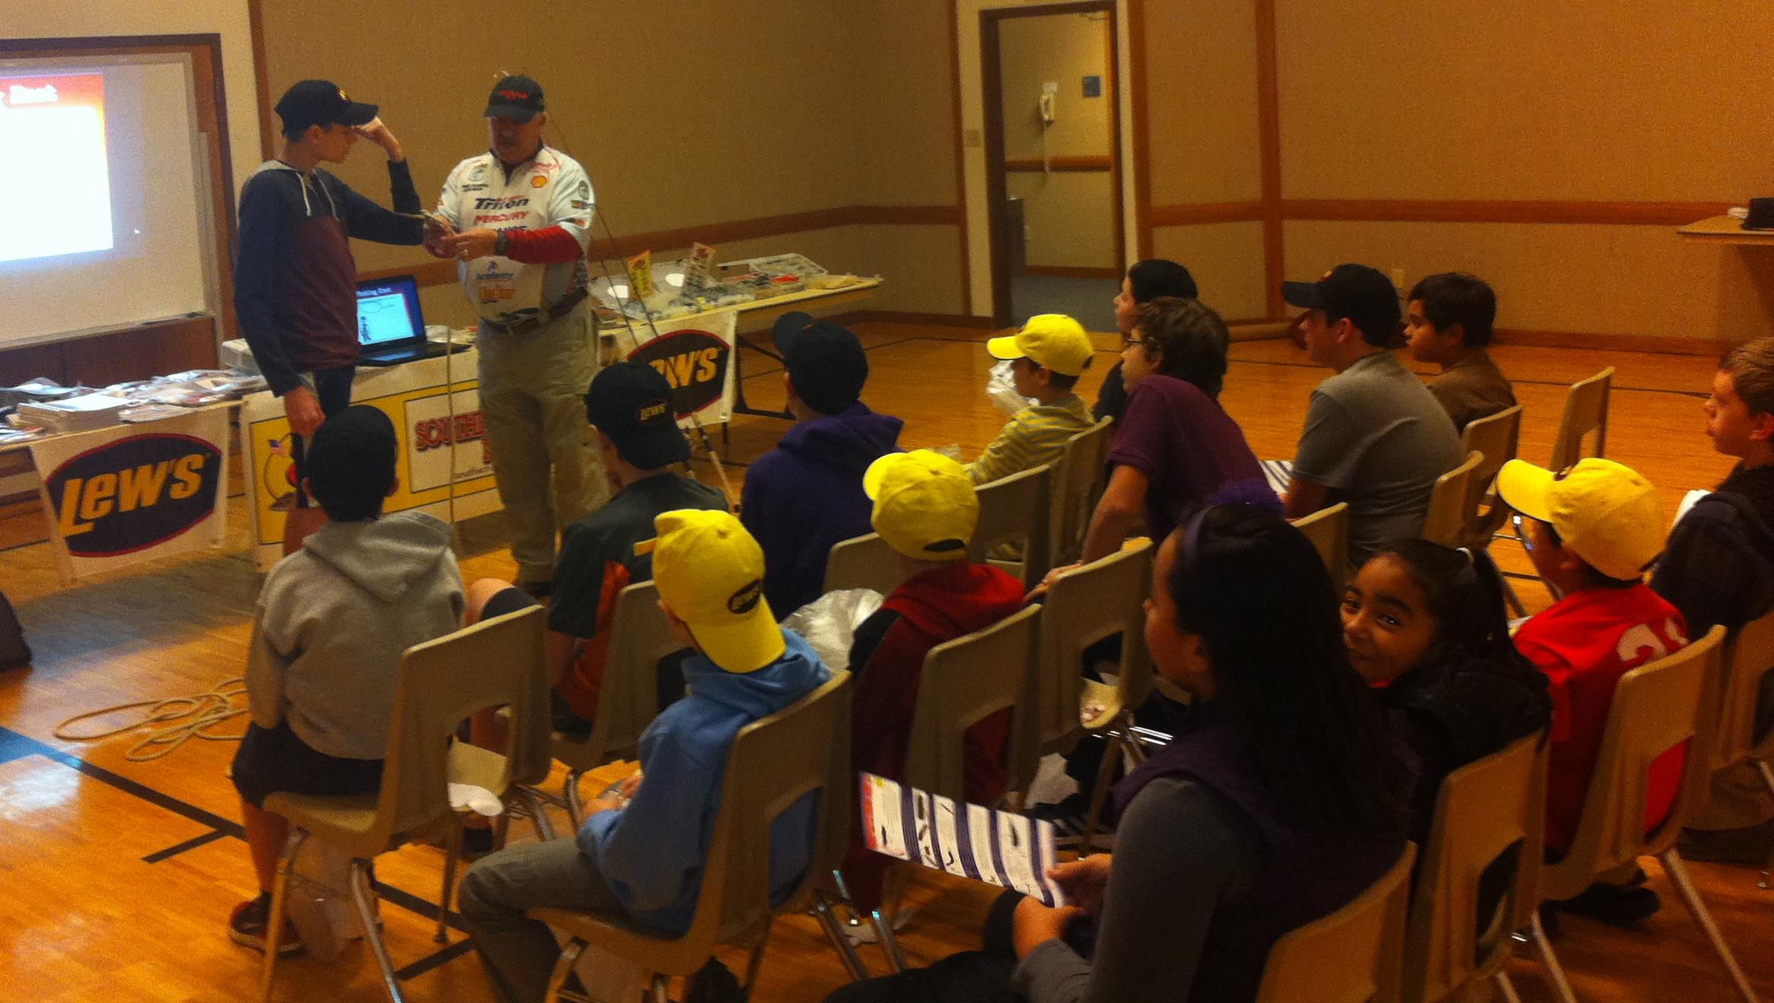
Notes:
First, thank you for having me as your guest! Who’s ready to talk about the wonders of Tupperware ? If you raised your hand you are really in the wrong room!
No, seriously, we are going to talk about finesse fishing. My name is Ron McDonald & I am the publisher & editor of SFN. You can call me Mr. Mac, BubbaMac or Big Mac but don’t ever call me a quarter pounder! Please.
I am not a pro, semi-pro or even a top ten local tournament bass fisherman. I am average to below average. Now don’t get me wrong, I am an expert fisherman...I just have trouble with the catching part every now and then!
I’d like to mention this class is sponsored by SFN, Slider Lures, Bass Minder, Diachi Hooks & West End Outdoors in Athens. They provided the stuff in your goodie bags & the draw prizes.

Slide 2
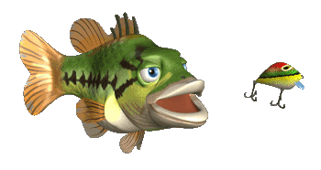
Origins of our modern luress
This Student Angler Class is about antique lures that laid the foundation for the modern lures we have today. On many slides we have included a modern version.

Slide 3
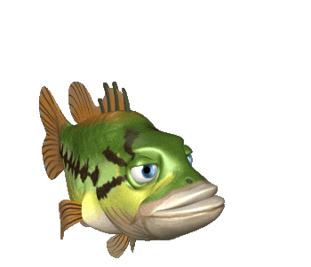
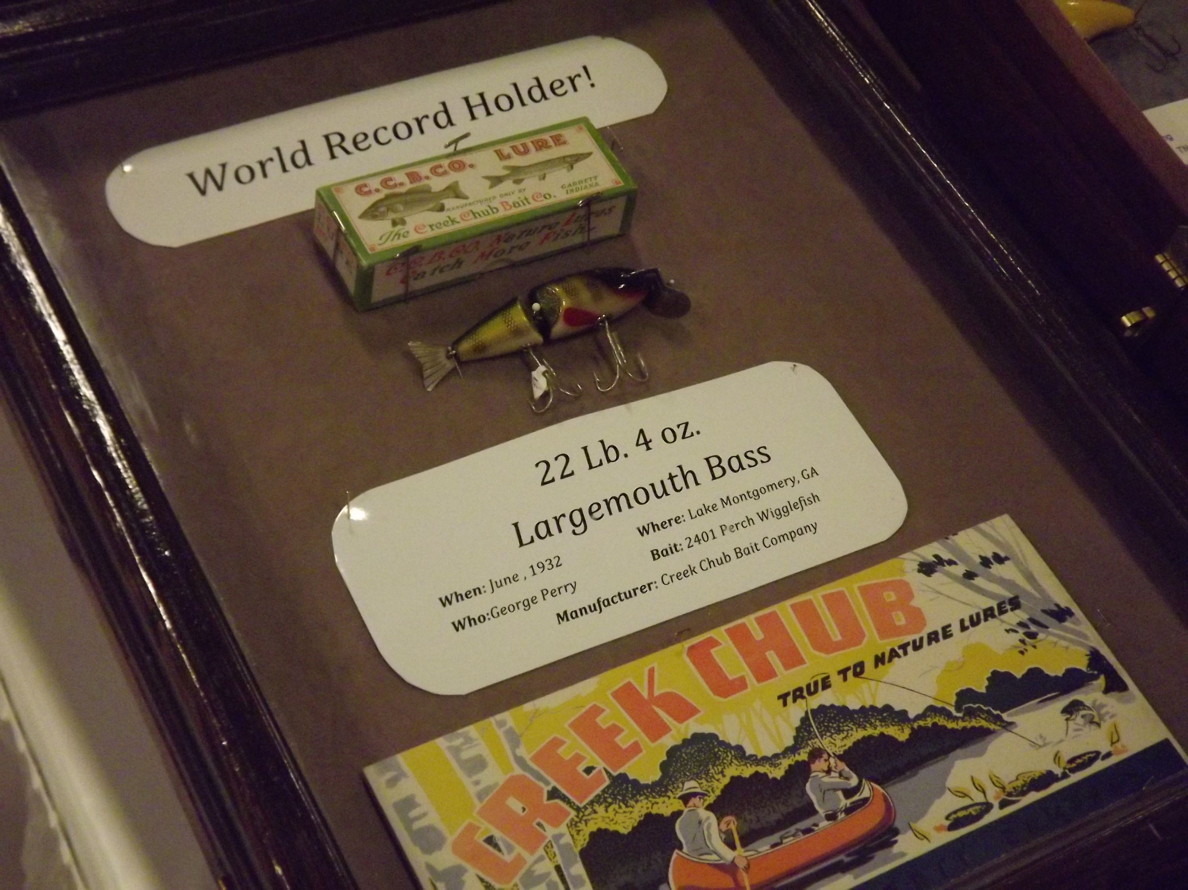
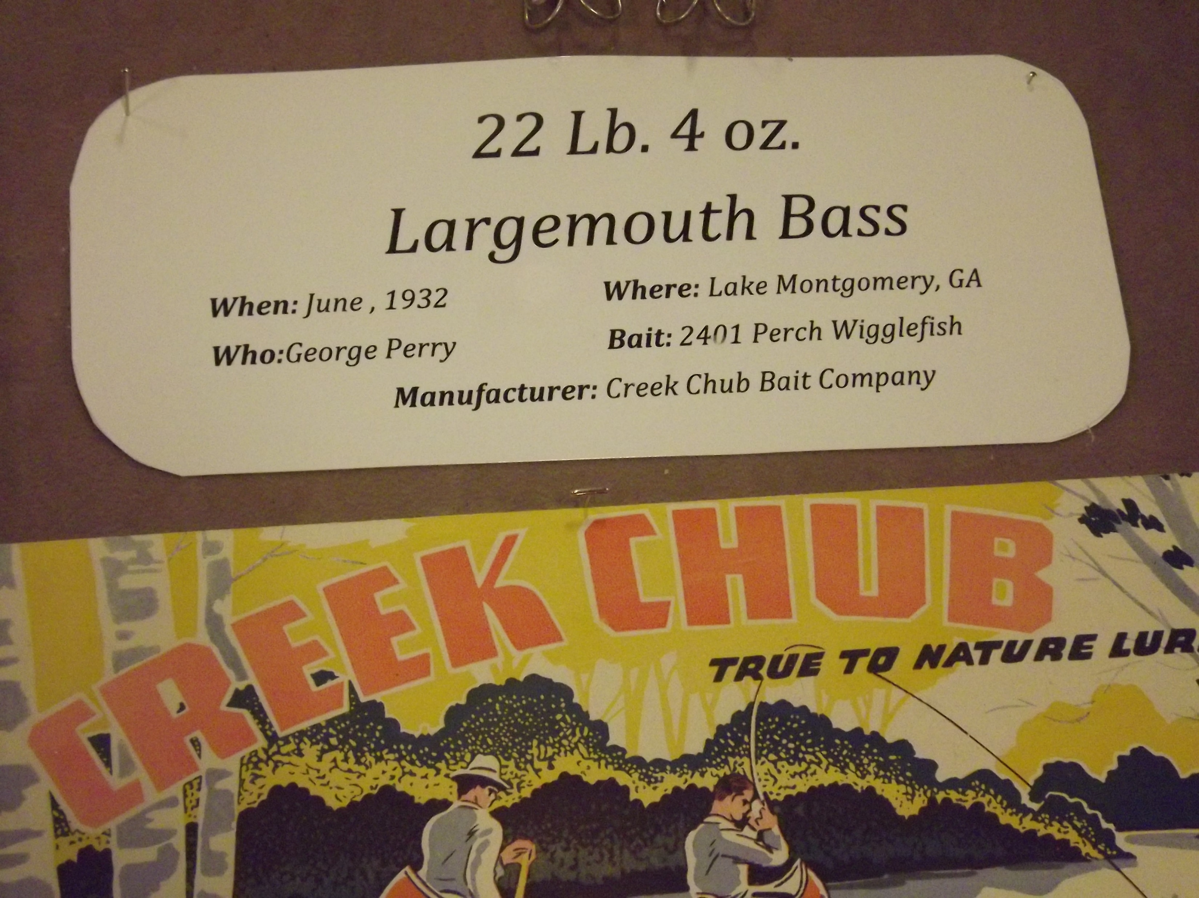
^{World Record Largemouth 1932}
Notes:
^{Today/tonight} I’m going to talk to you about finesse fishing, Tell you what you can do with it, share a few tips and tricks .
^{Finesse fishing is another} fishing tool in your tacklebox .

Slide 4
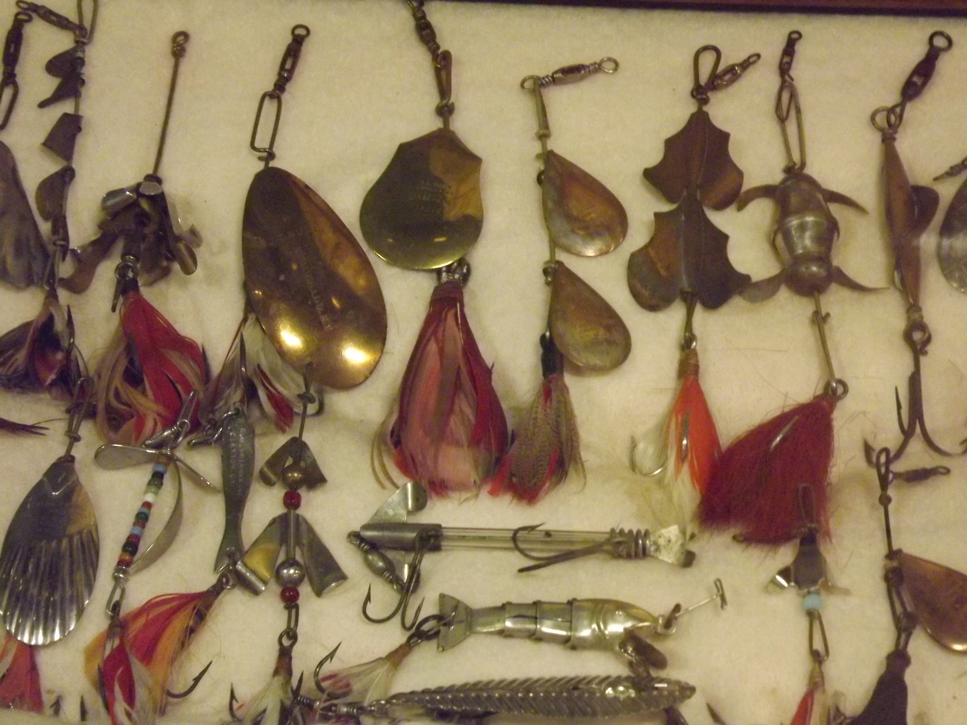
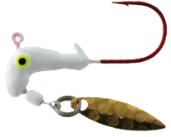
^{Inline spinner ancestors}
CHECKOUT THE BLADE SHAPES
Road Runner

Slide 5
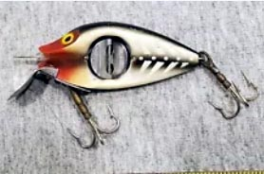
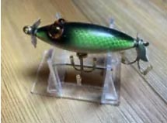
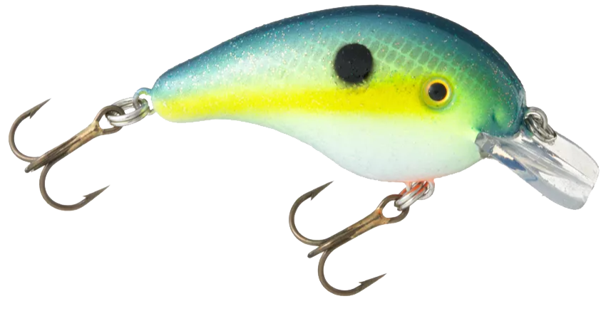
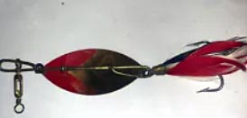
^{Square bill, topwater and} ^{inline spinner styles}
Teddy Bear Eye Wood Minno
Uniline Spinno Minno
Strike King Pro Model square bill
Pflueger Peacock Feather

Slide 6
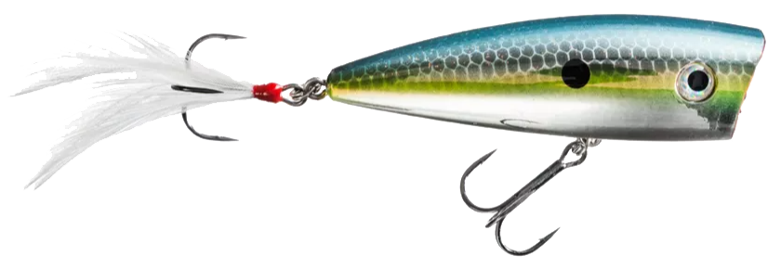
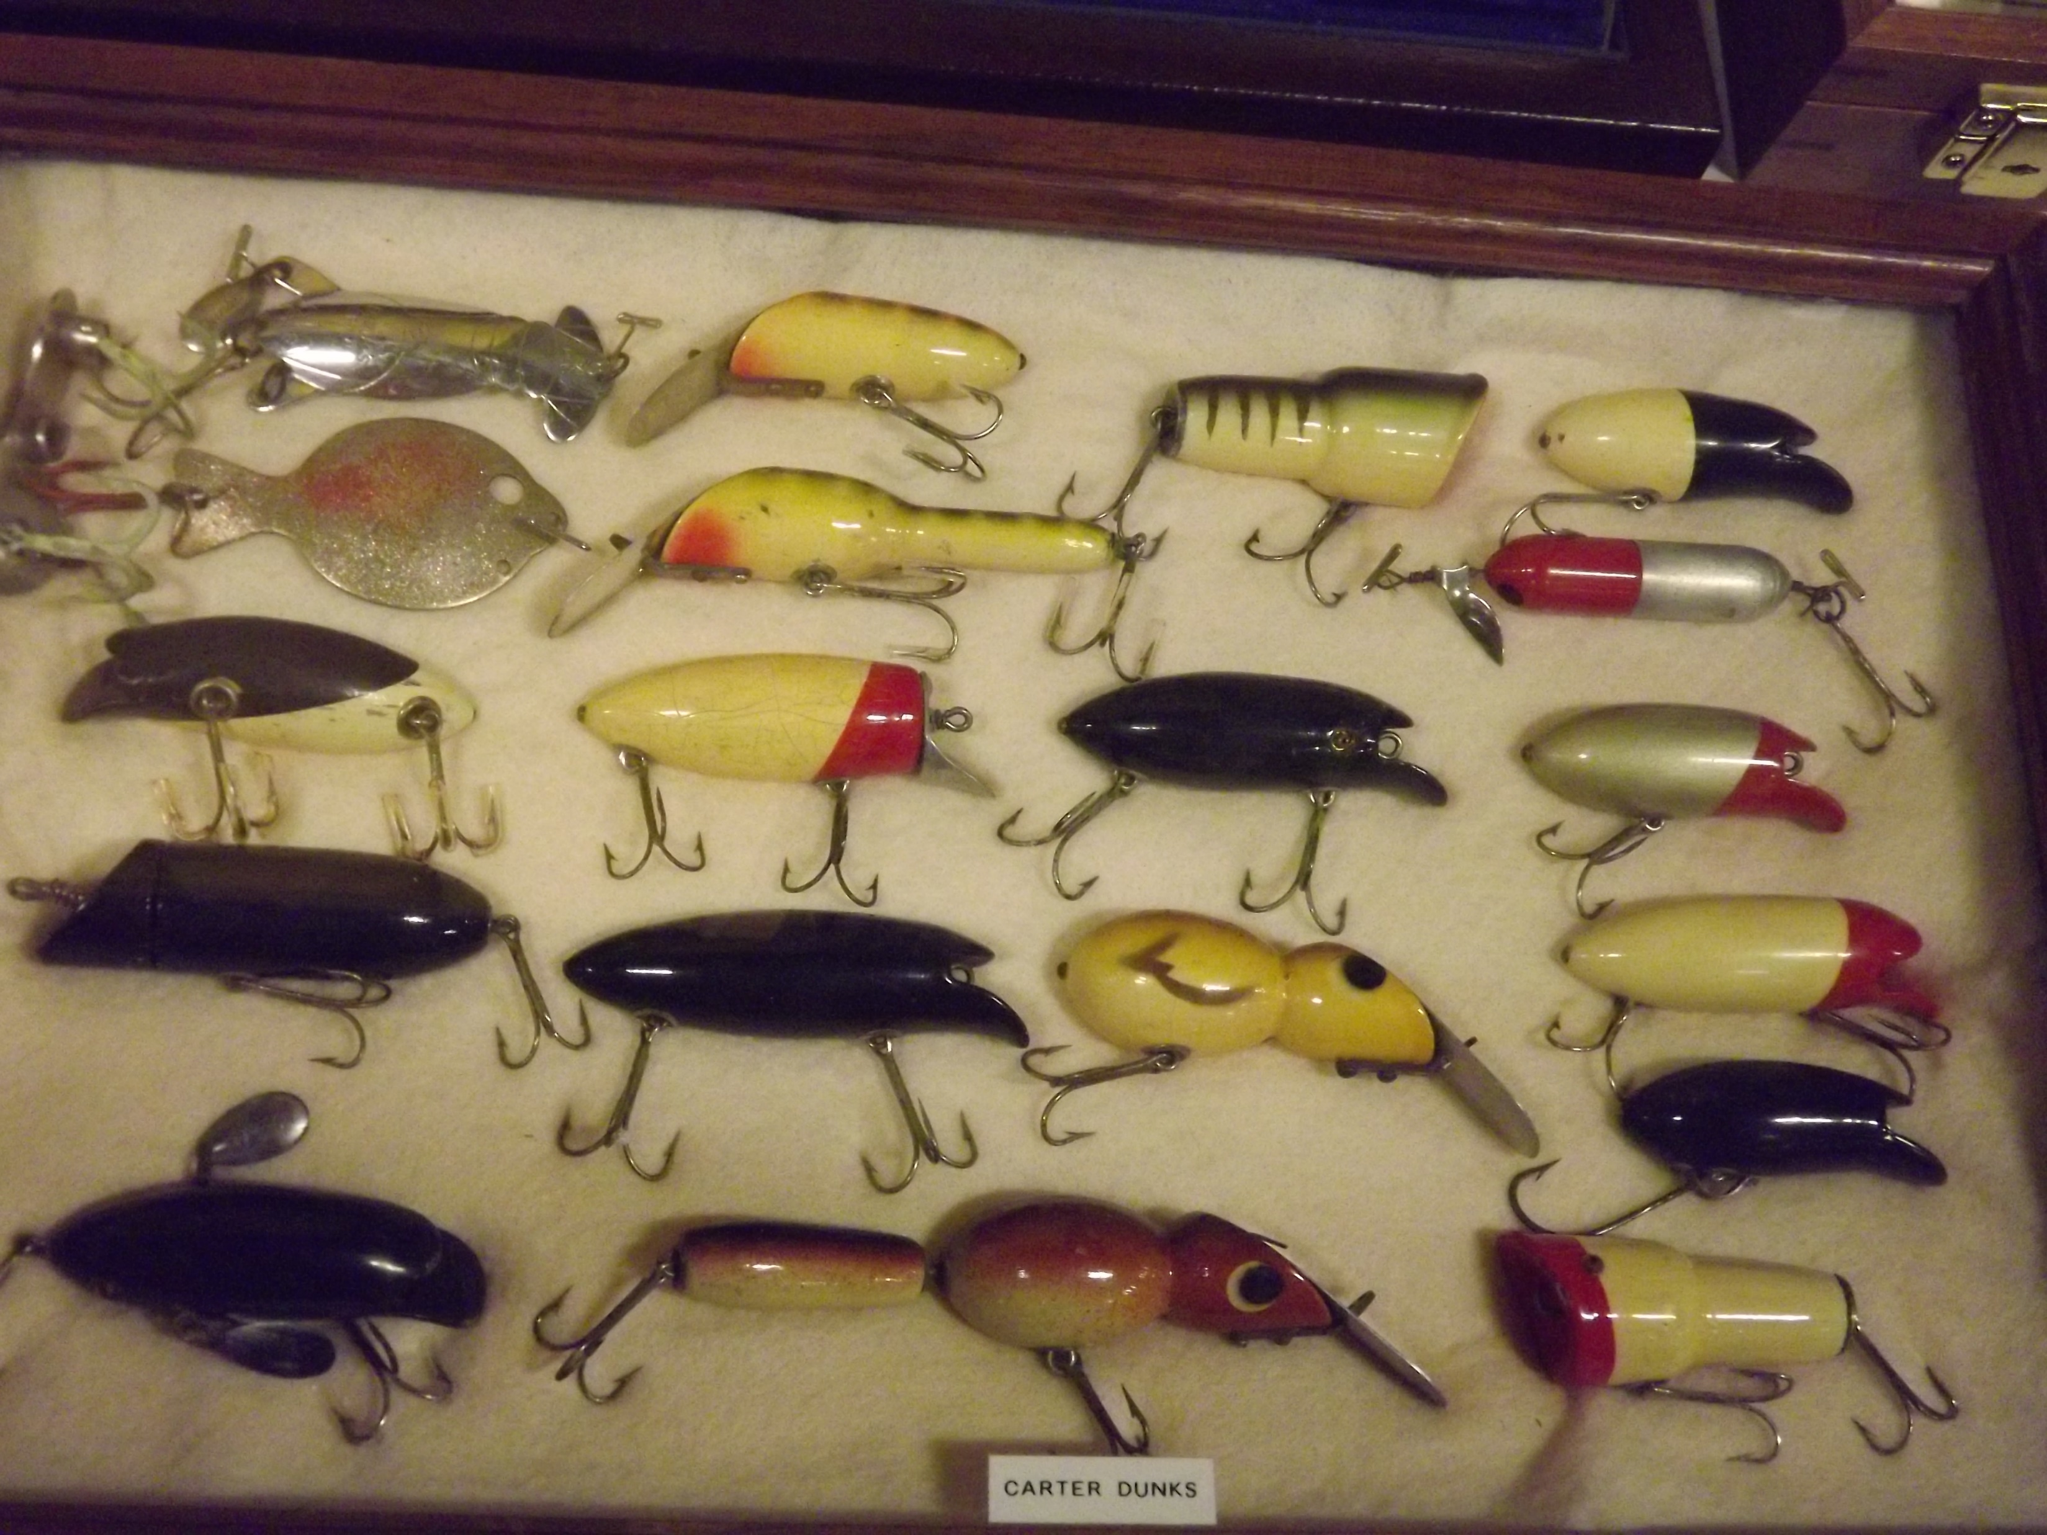
^{Topwaters and divers}
Strike King KVD Splash
Notes:
So here we go. First let’s watch a 6 min. Video to give you an introduction to Slider Lures ^{(Show TN Crossroads video)}

Slide 7
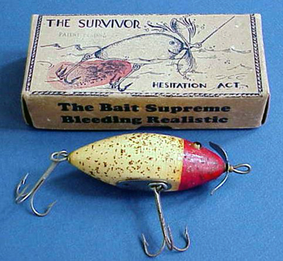
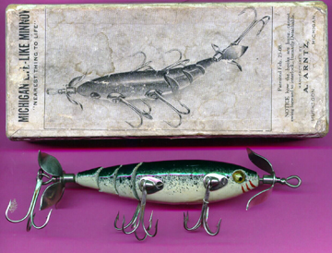
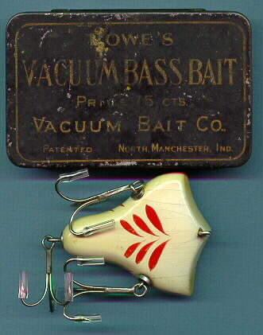
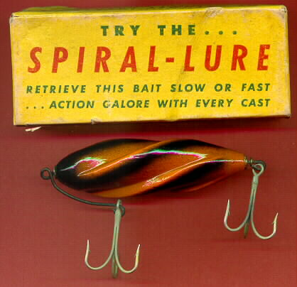
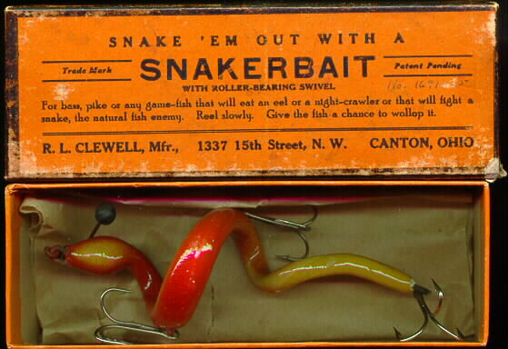
Antique lures with the original box
Needs more hooks…

Slide 8
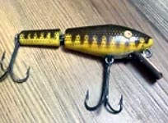
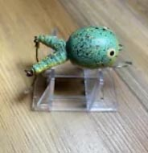
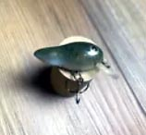
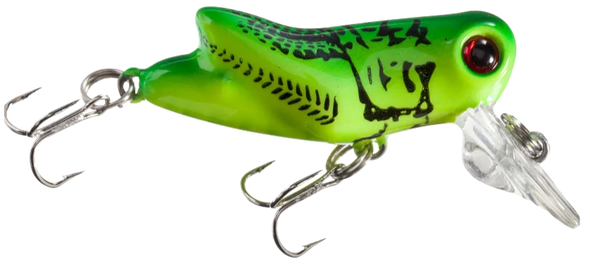
^{Squarebill/swimbait} ^{and something else}
L&S Bass Master
Poly Frog 1930’s
BPS XTS Mini Hopper
Rebel Tadfly

Slide 9
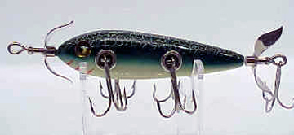
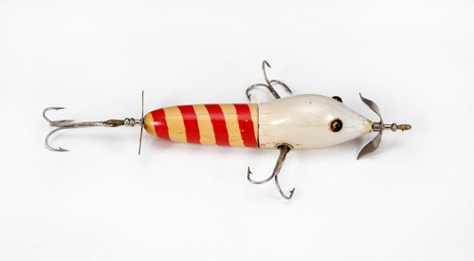
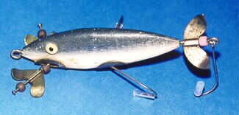
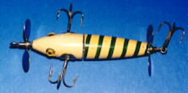
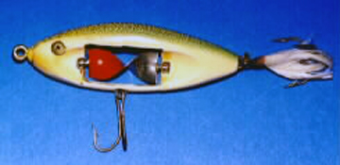
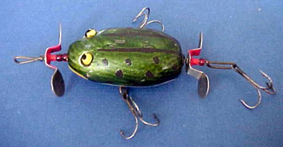
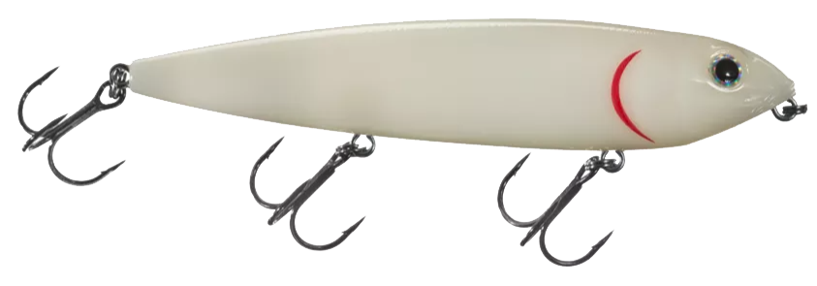
^{early topwater lures}
Strike King Sexy Dawg

Slide 10
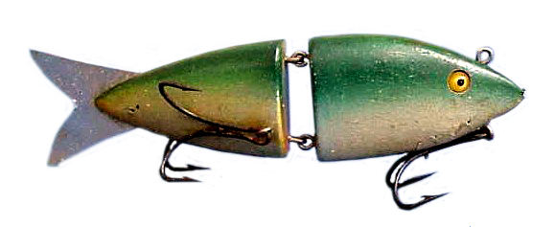
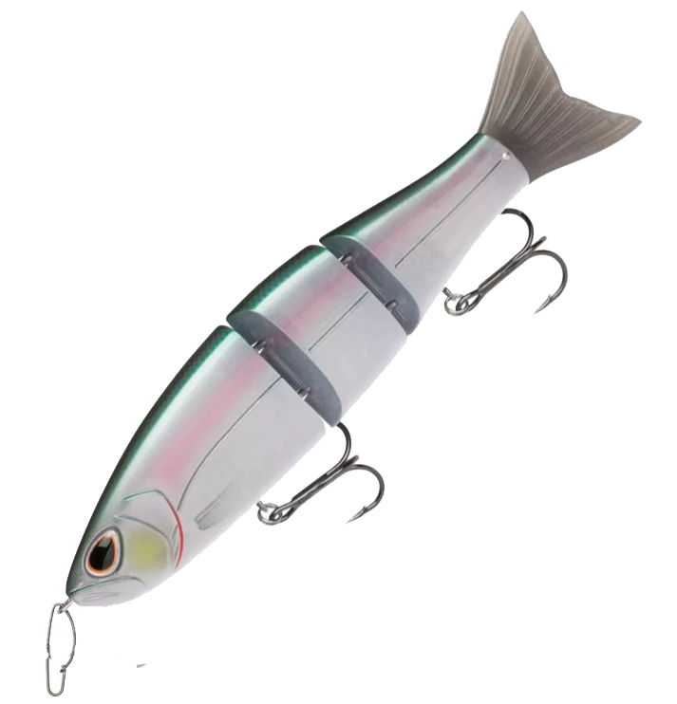
The original swimbait?
Storm Arashi
Notes:
So here we go. First let’s watch a 6 min. Video to give you an introduction to Slider Lures ^{(Show TN Crossroads video)}

Slide 11
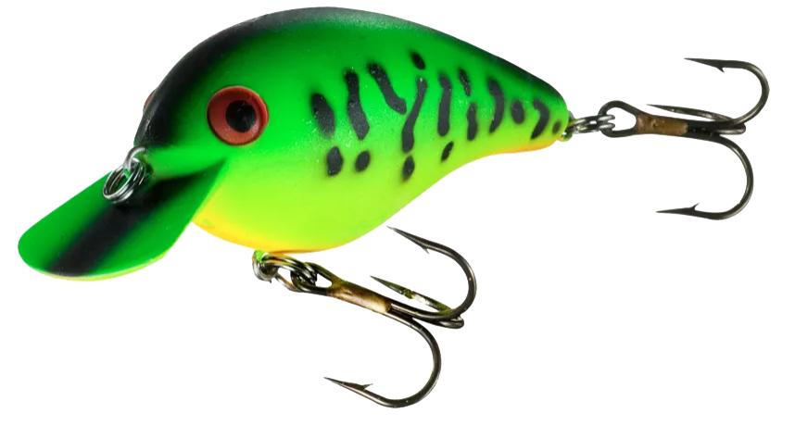
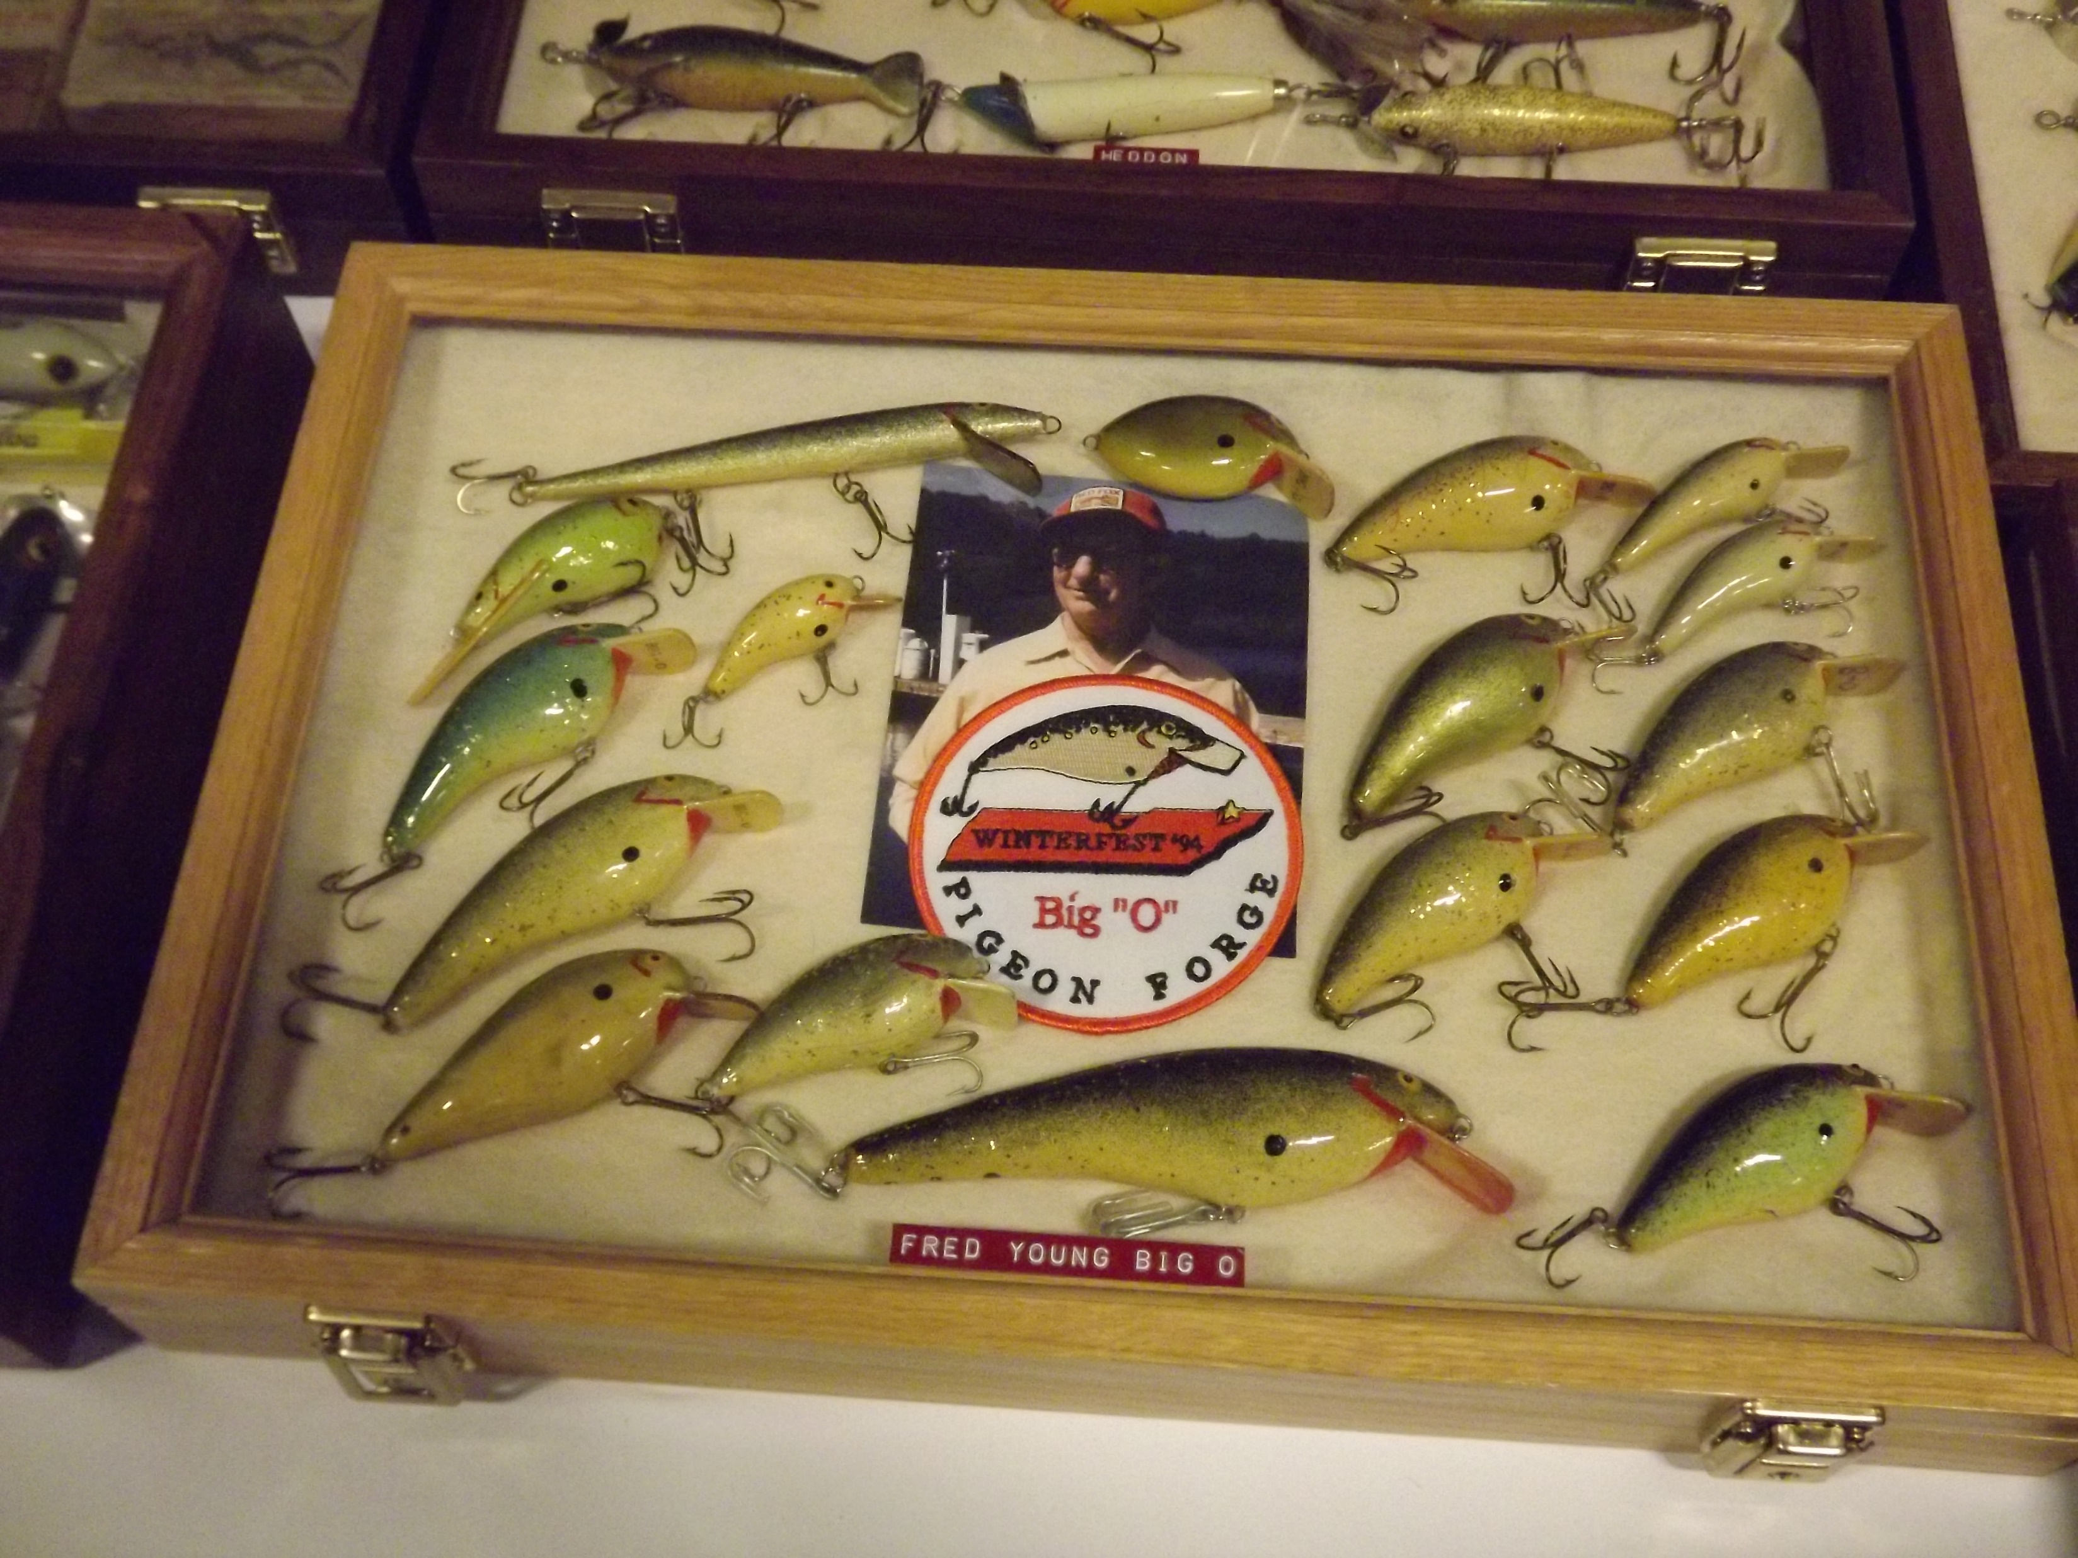
The Balsa Big o
THE NEW Big O

Slide 12
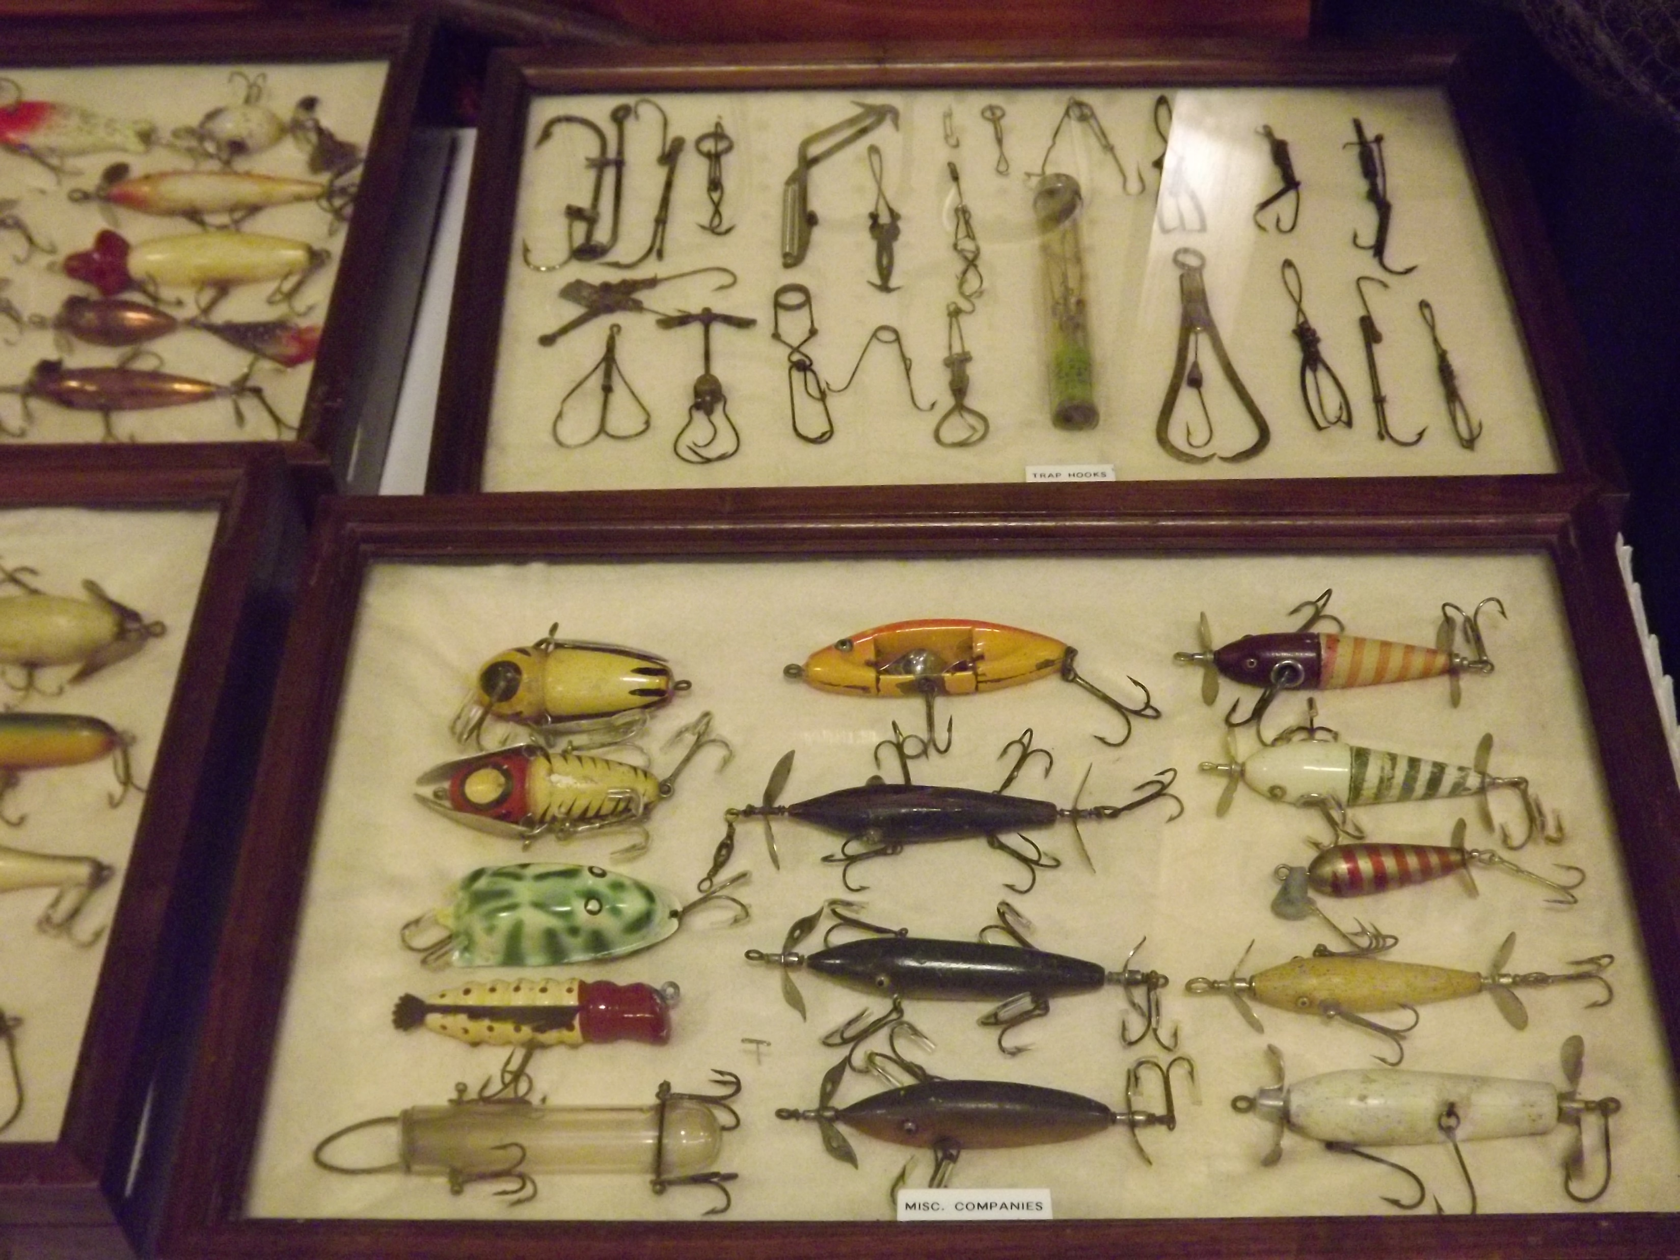
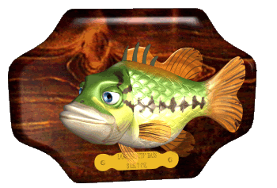
^{They caught fish, we think}

Slide 13
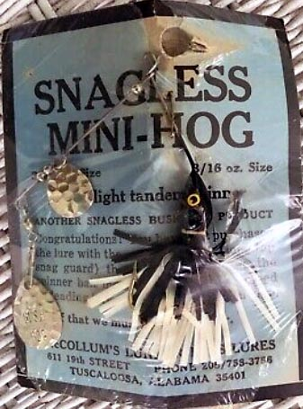
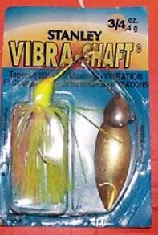
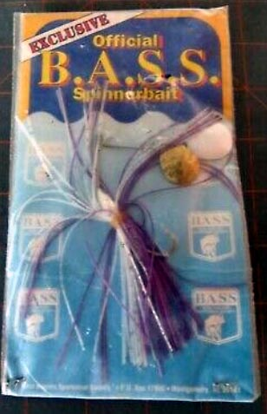
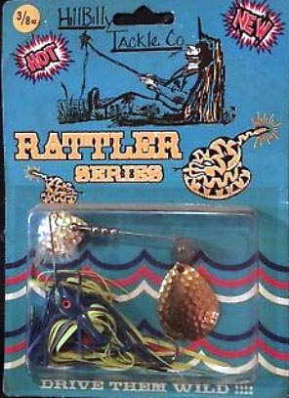
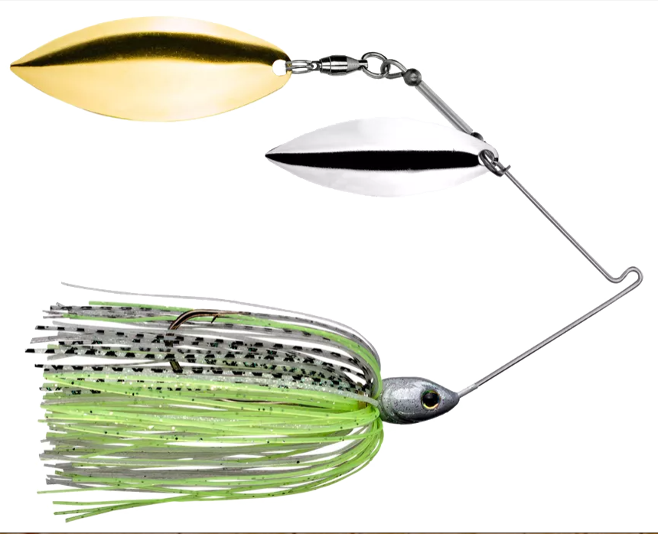
^{Some classic spinnerbaits}
Strike King
Perhaps the best improvements to spinnerbaits are the blade shapes, quality blade swivel and skirts.

Slide 14
Now you can appreciate the lure ^{designs that influenced our} ^{modern lures.}
But you gotta admit, these antique lures Were quite imaginative!

Slide 15
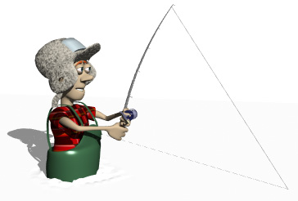
southernfishingnews.com Southern Fishing News also on
Facebook
LinkedIn
Twitter
Printerest
Instagram
MeWe
Email Us at publisher@southernfishingnews.com

Slide 16
