Slide 1
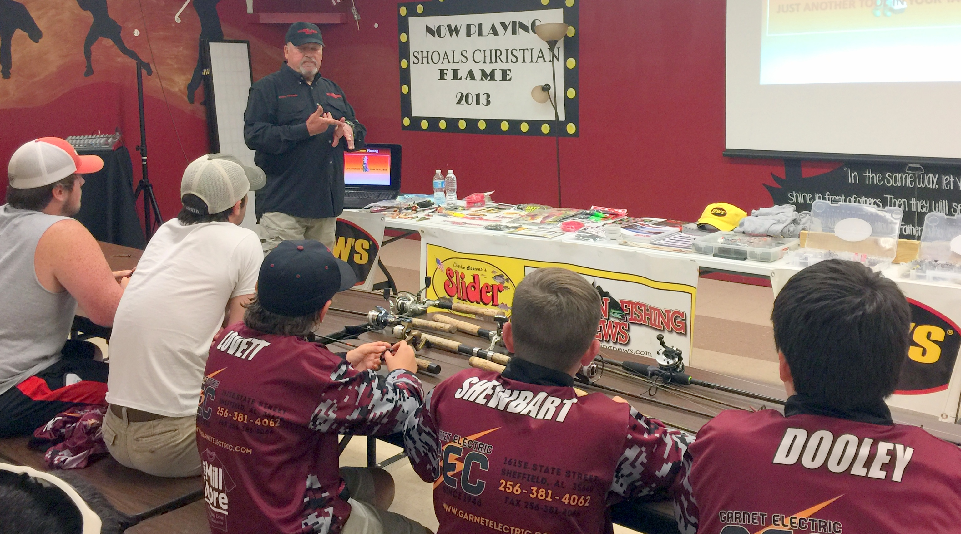
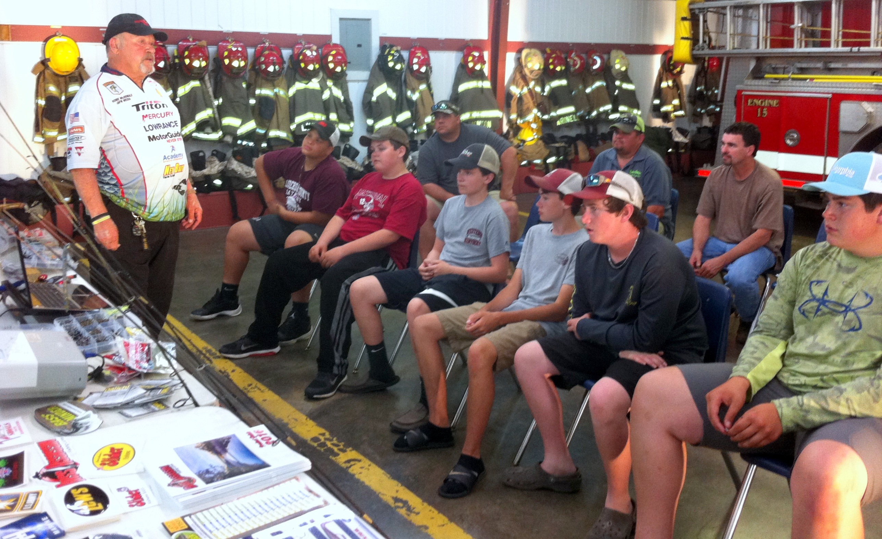
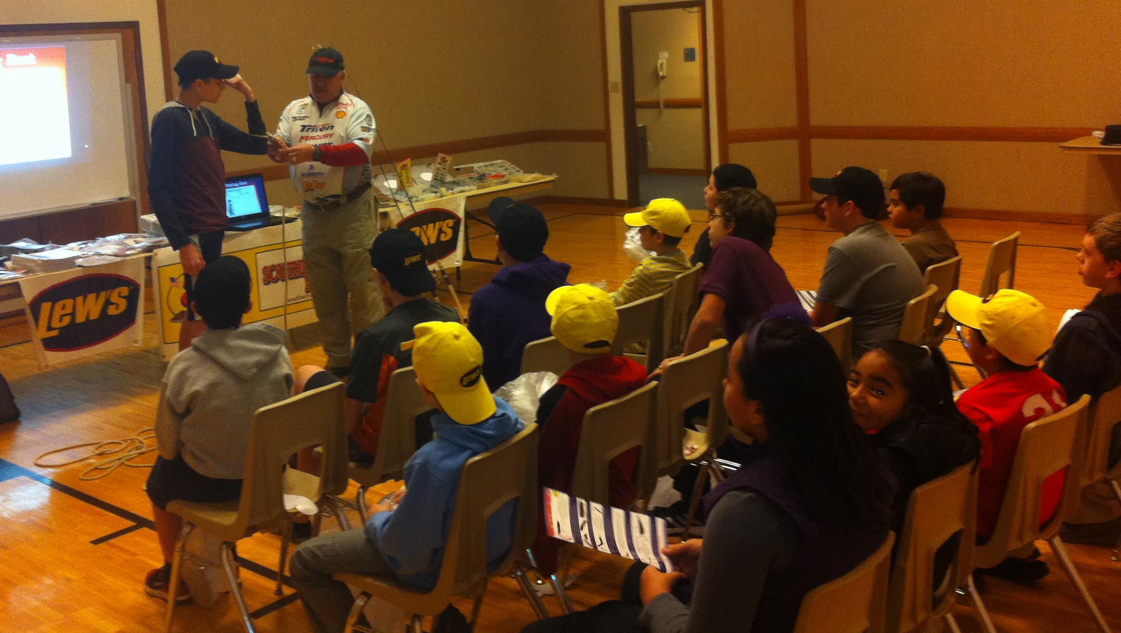
Notes:
First, thank you for having me as your guest! Who’s ready to talk about the wonders of Tupperware ? If you raised your hand you are really in the wrong room!
No, seriously, we are going to talk about finesse fishing. My name is Ron McDonald & I am the publisher & editor of SFN. You can call me Mr. Mac, BubbaMac or Big Mac but don’t ever call me a quarter pounder! Please.
I am not a pro, semi-pro or even a top ten local tournament bass fisherman. I am average to below average. Now don’t get me wrong, I am an expert fisherman...I just have trouble with the catching part every now and then!
I’d like to mention this class is sponsored by SFN, Slider Lures, Bass Minder, Diachi Hooks & West End Outdoors in Athens. They provided the stuff in your goodie bags & the draw prizes.

Slide 2
antique Lures From Days Gone Past
This Student Angler Class is about antique lures that laid the foundation for the modern lures we have today.

Slide 3
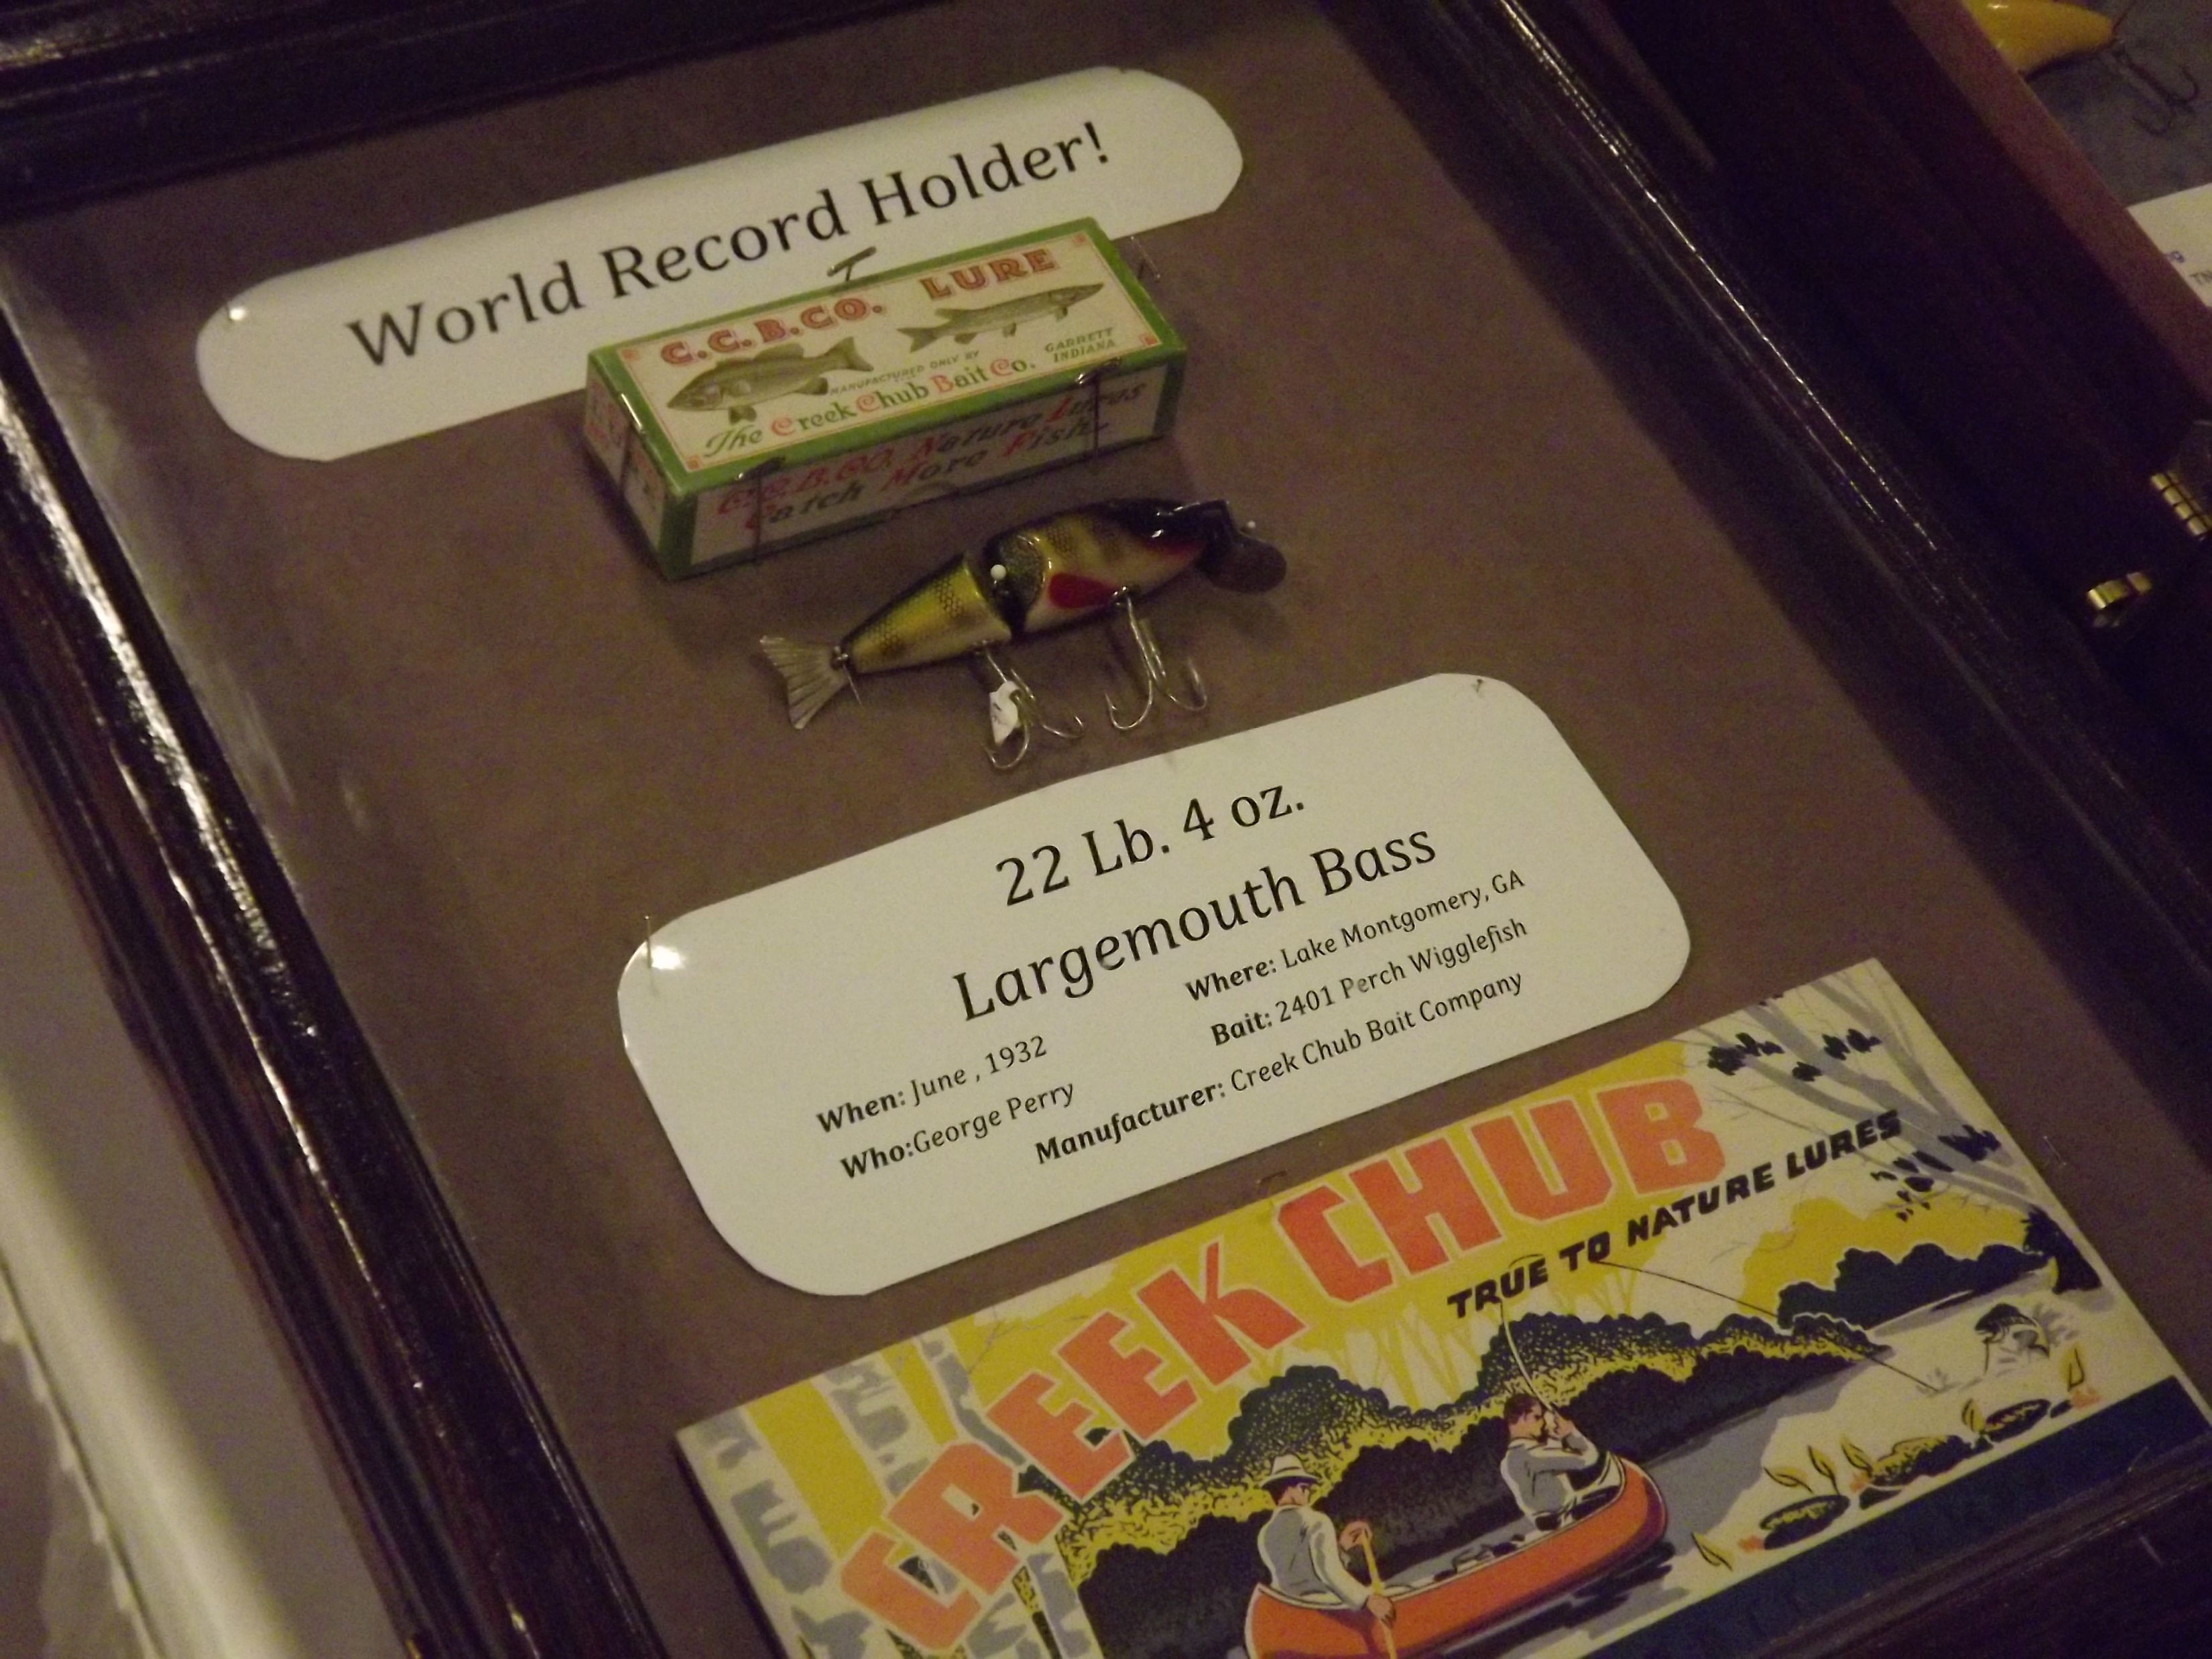
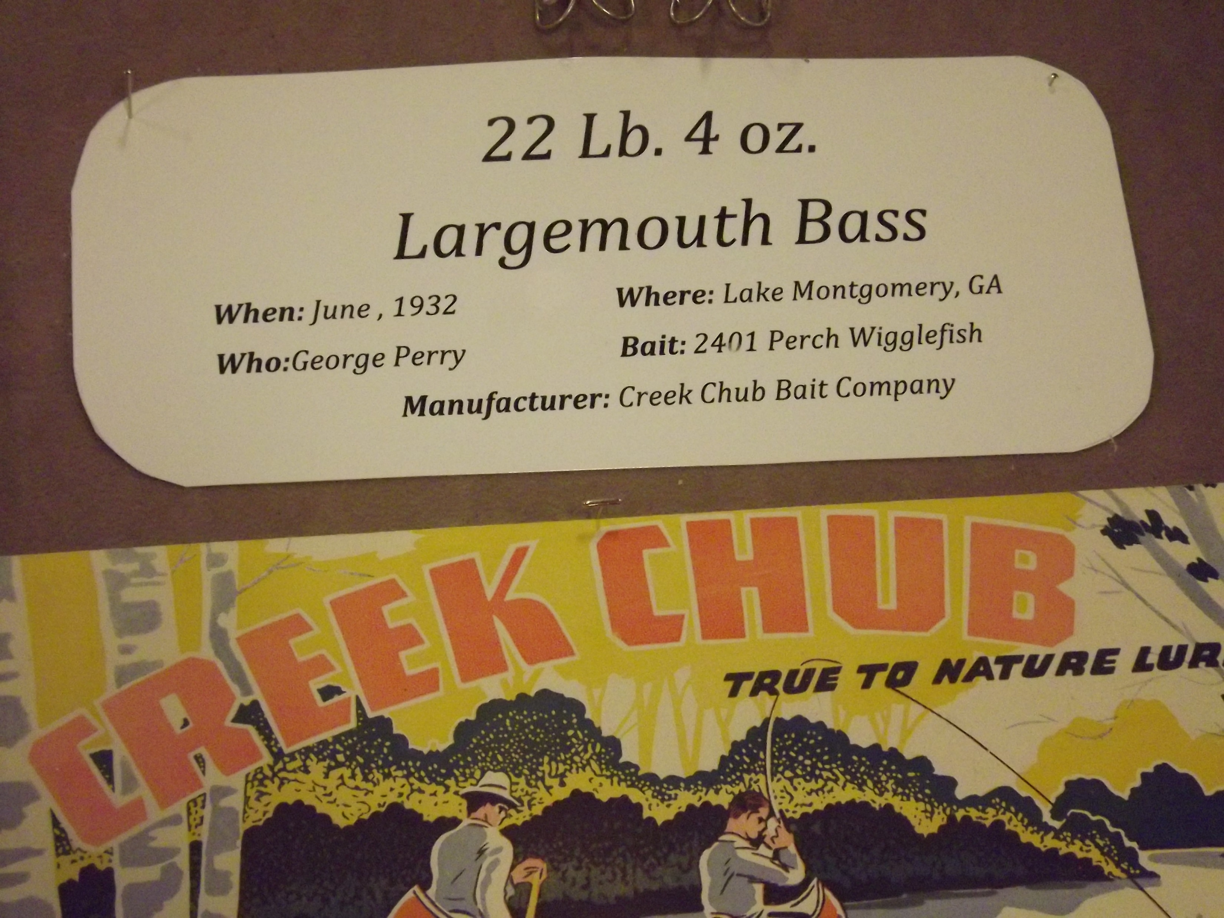
^{World Record Largemouth 1932}
Notes:
^{Today/tonight} I’m going to talk to you about finesse fishing, Tell you what you can do with it, share a few tips and tricks .
^{Finesse fishing is another} fishing tool in your tacklebox .

Slide 4
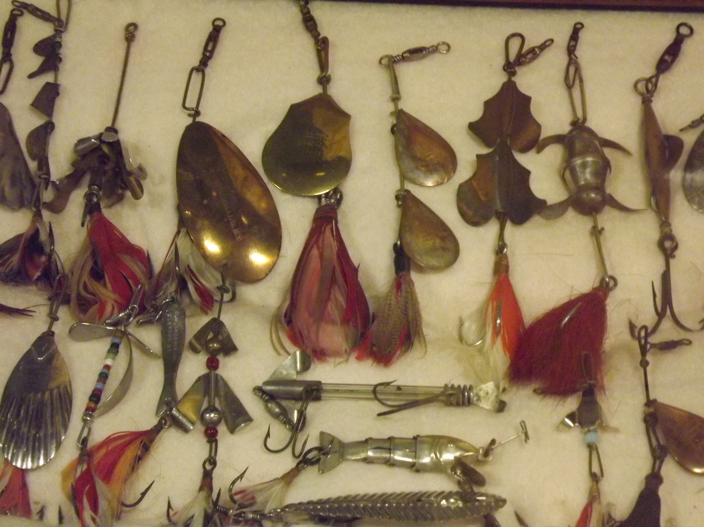
^{rooster tail ancestors}
CHECKOUT THE BLADE SHAPES

Slide 5
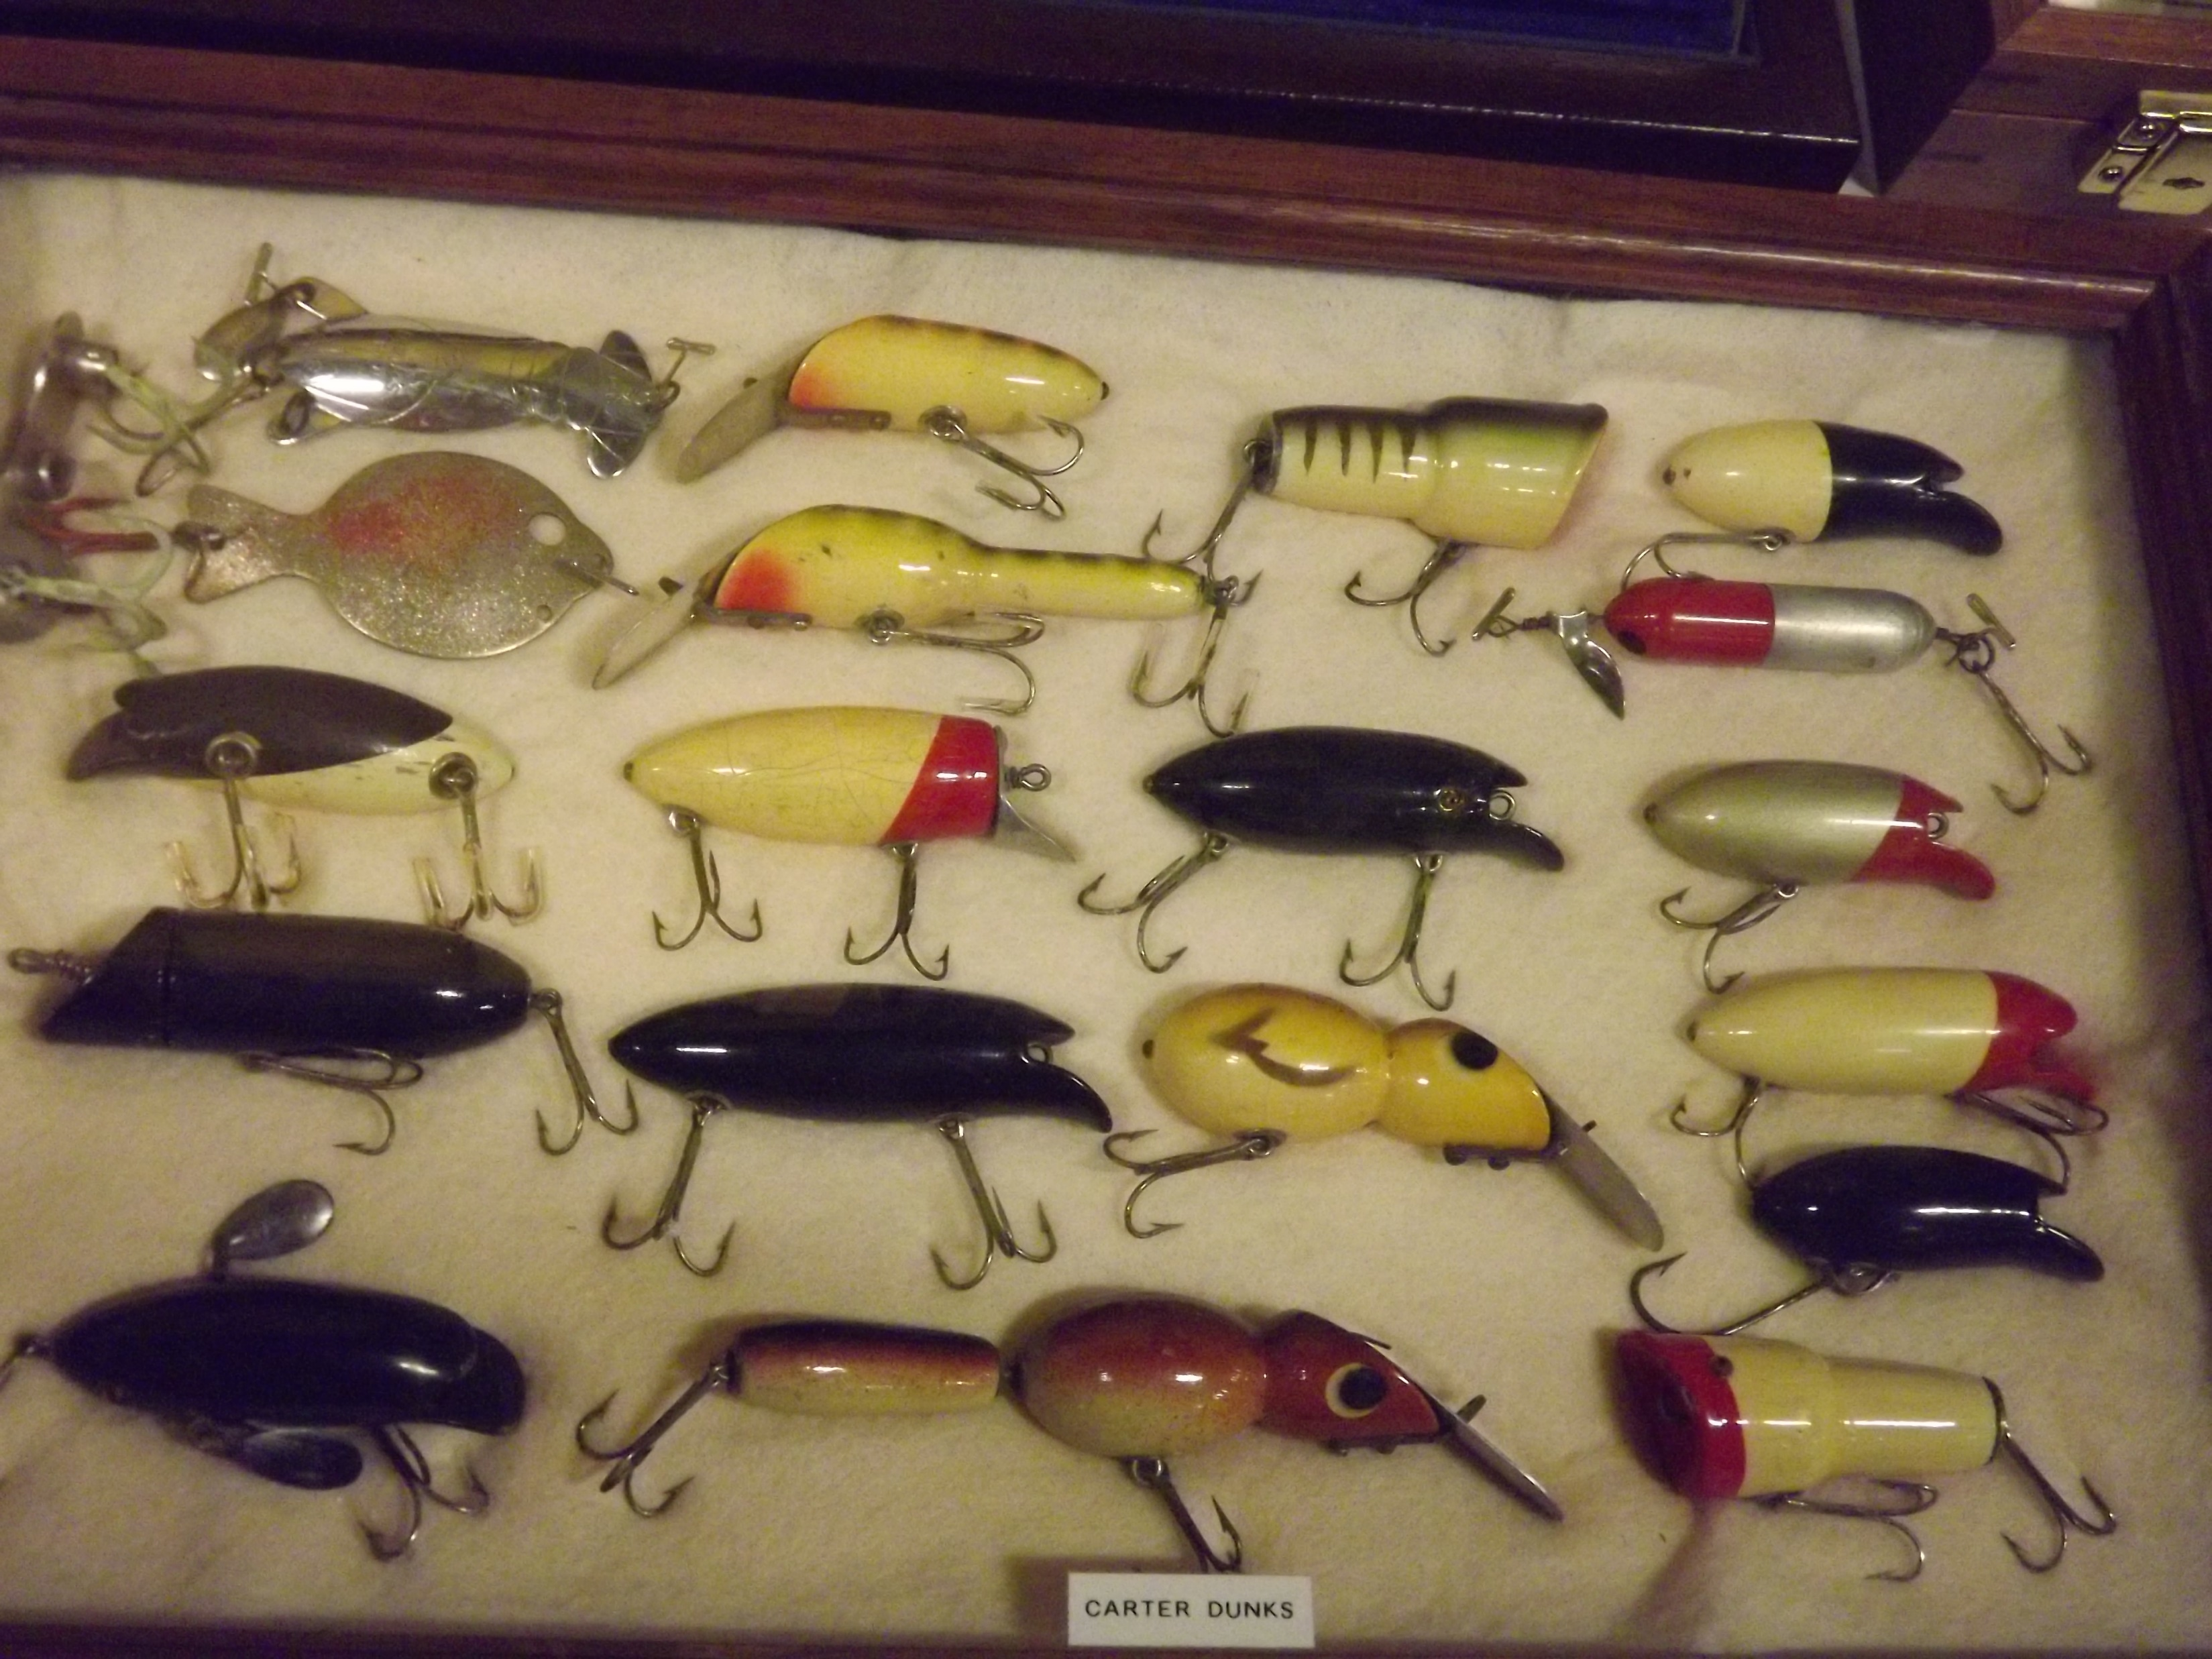
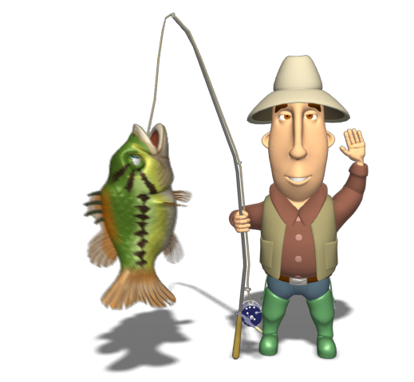
^{Topwaters and divers}
Notes:
So here we go. First let’s watch a 6 min. Video to give you an introduction to Slider Lures ^{(Show TN Crossroads video)}

Slide 6
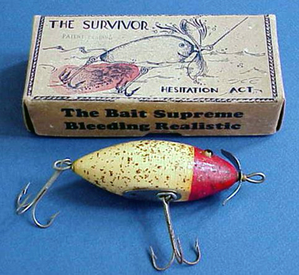
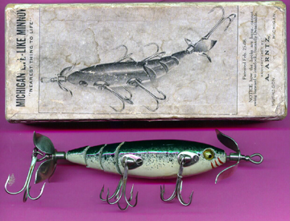
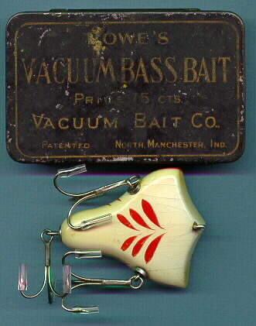
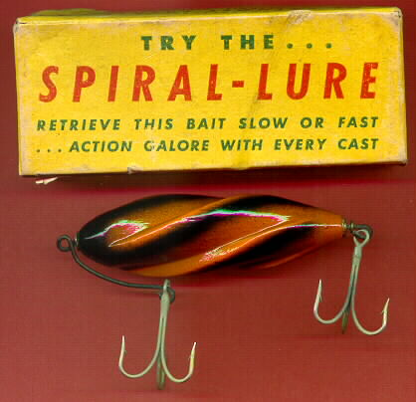
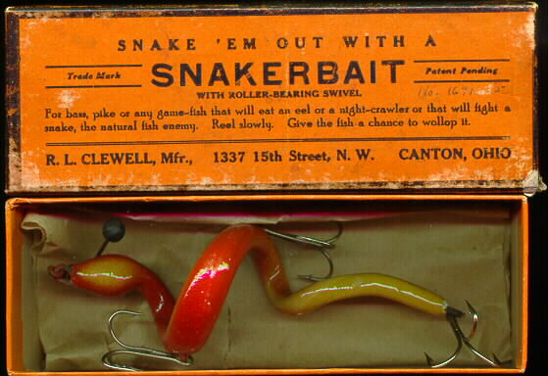
Antique lures with the original box

Slide 7
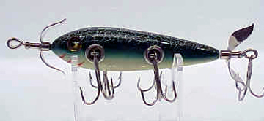
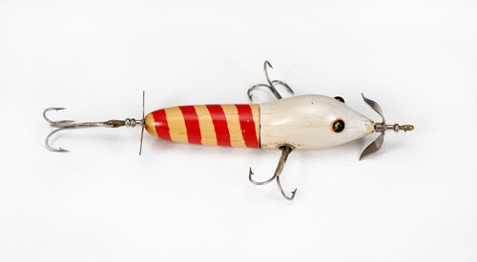
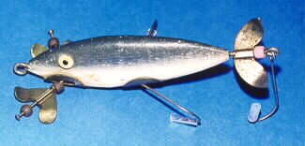
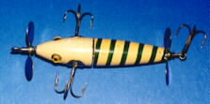
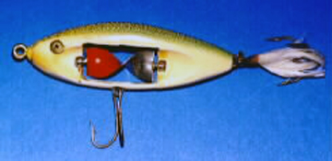
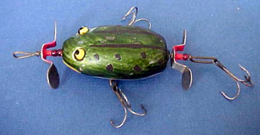
A few unique topwater selections

Slide 8
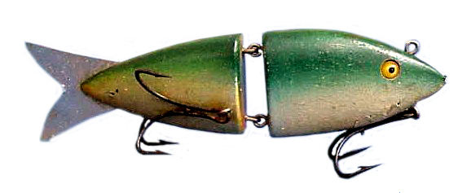
The original swimbait?
Notes:
So here we go. First let’s watch a 6 min. Video to give you an introduction to Slider Lures ^{(Show TN Crossroads video)}

Slide 9
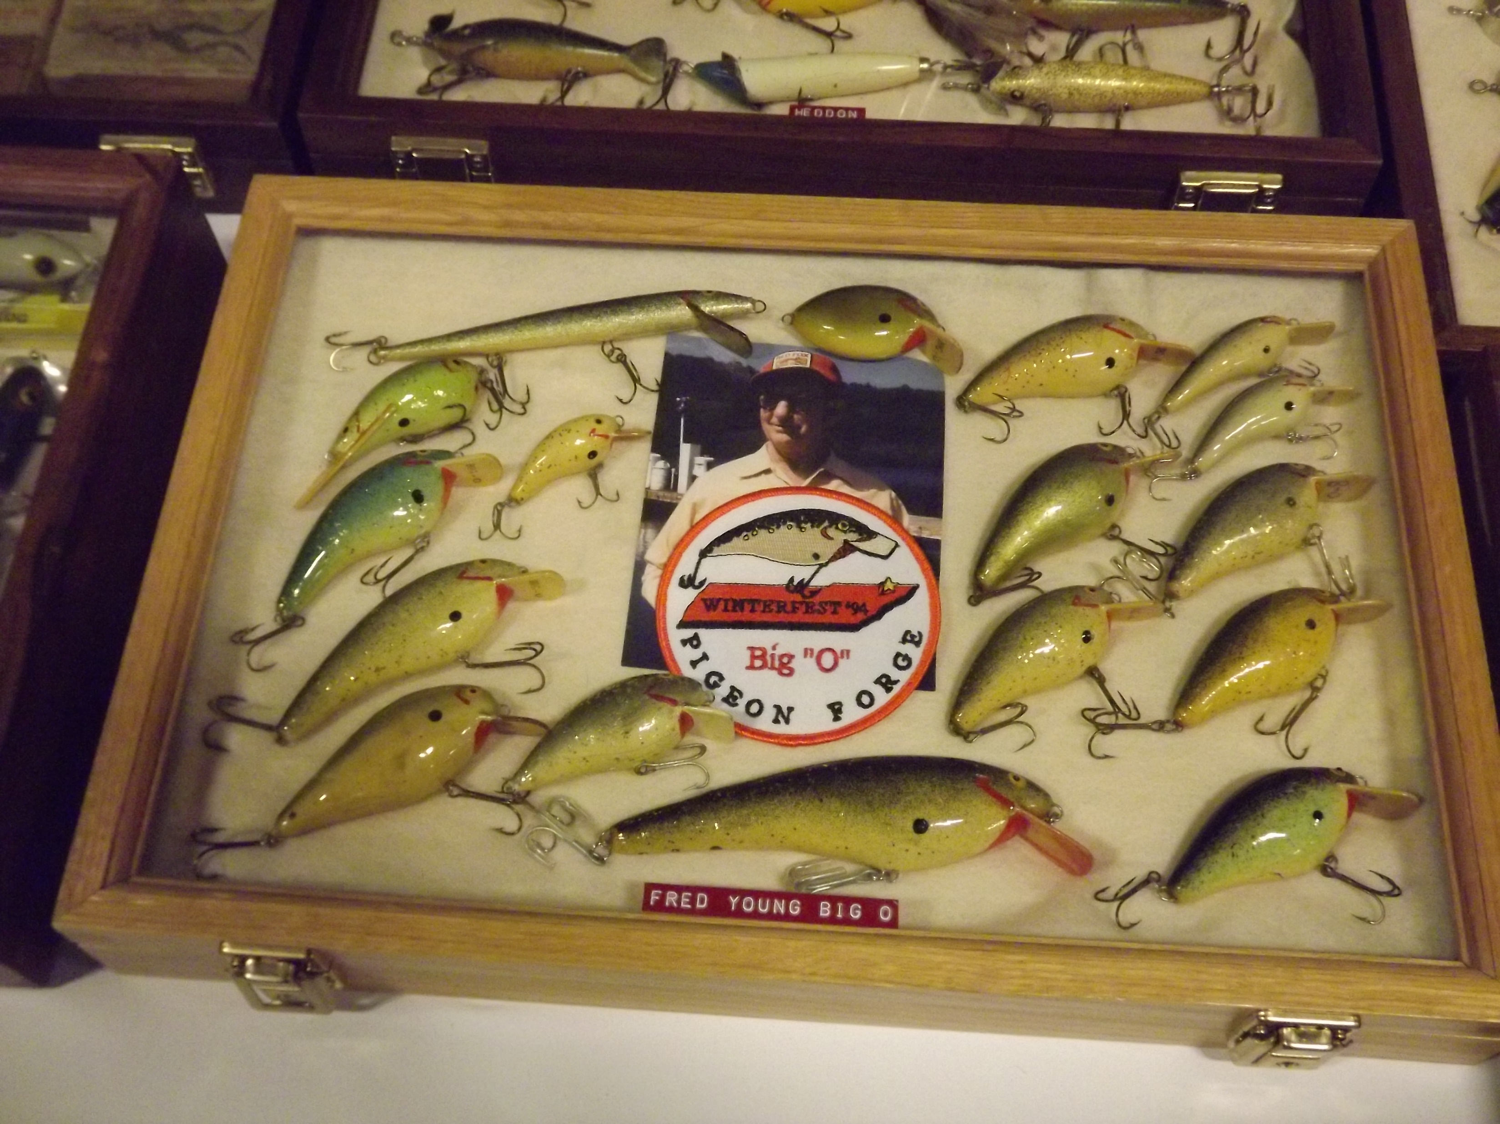
The Balsa Big o

Slide 10
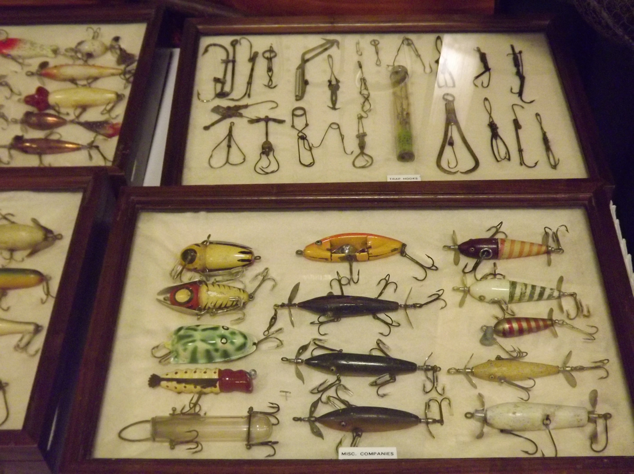
^{They caught fish} !

Slide 11
Now you can appreciate the lure designs and selections available in tackle stores and online.
But you gotta admit, these antique lures Were quite imaginative!

Slide 12
southernfishingnews.com Southern Fishing News also on
Facebook
LinkedIn
Twitter
Printerest
Instagram
MeWe
Email Us at publisher@southernfishingnews.com

