Slide 1
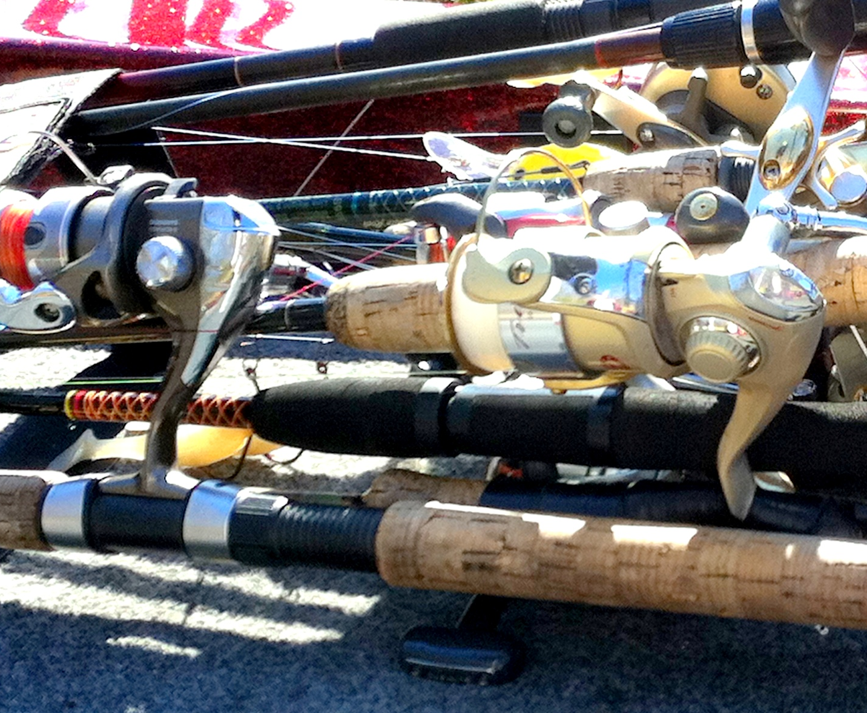
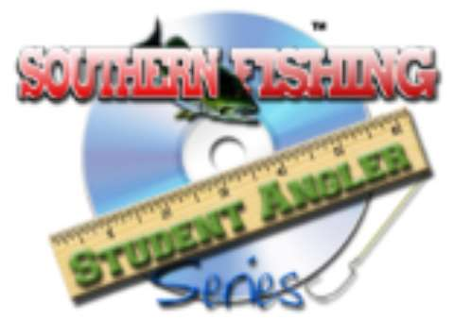
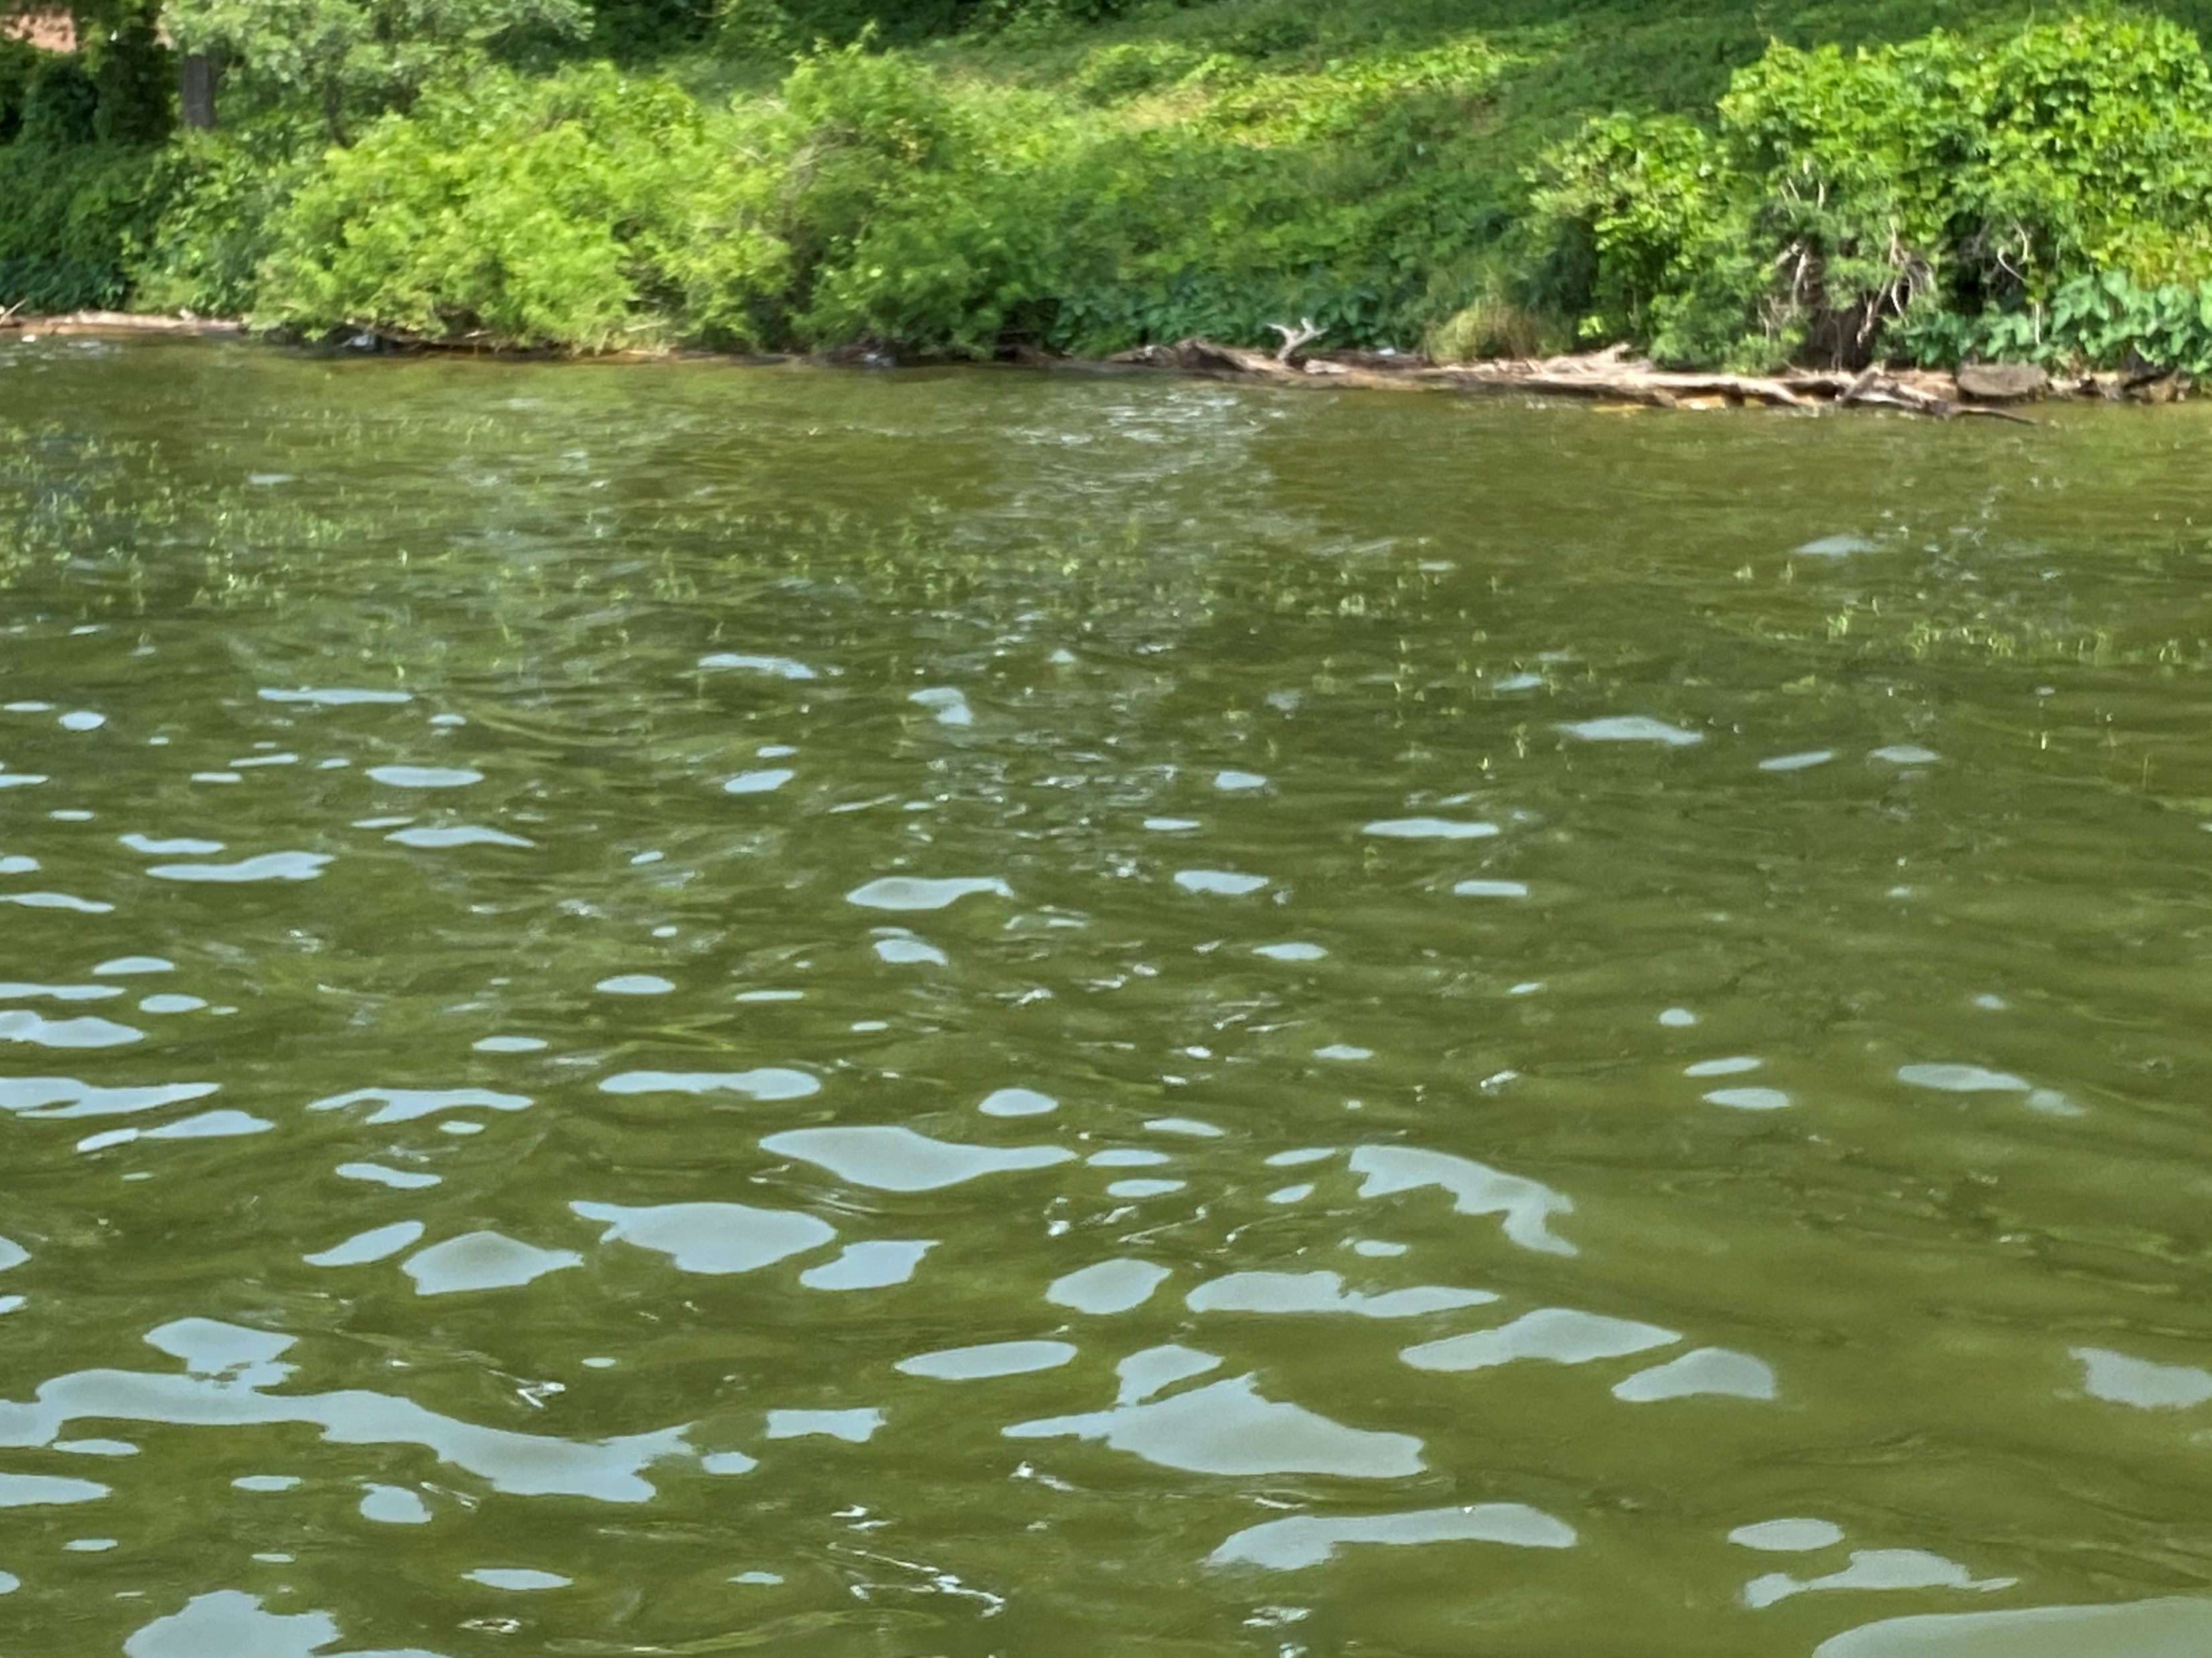
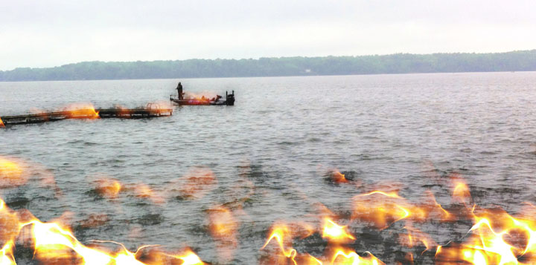
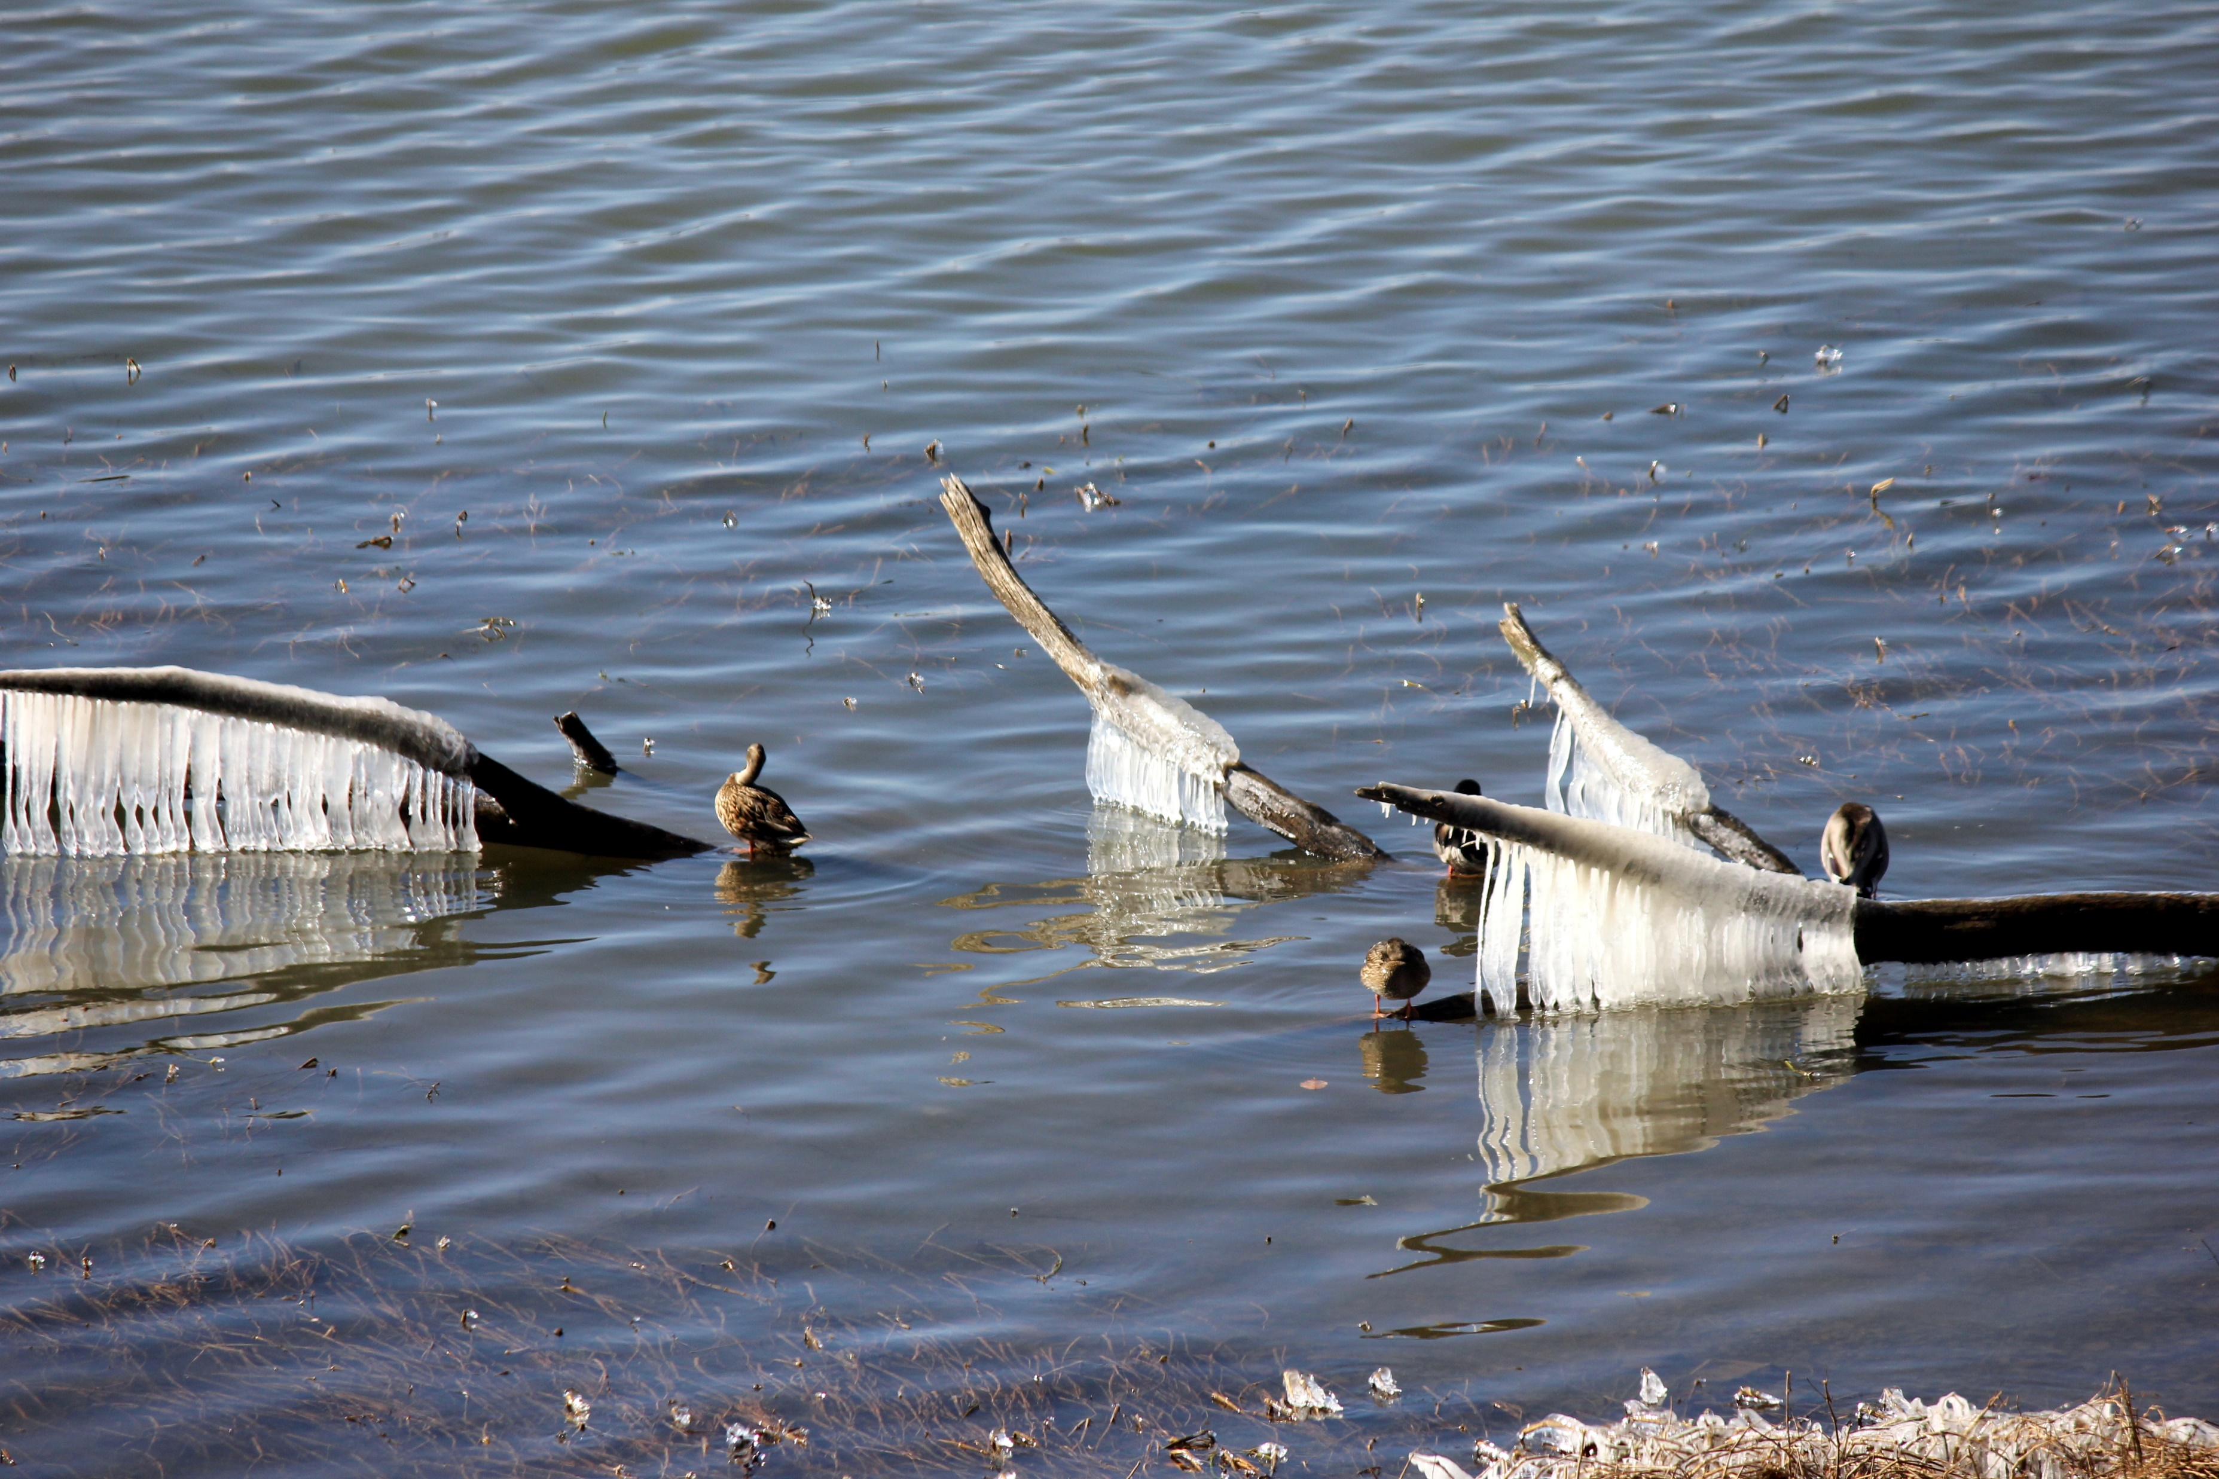
Seasonal Fishing Strategies for Largemouth Bass:
A Beginner’s Guide
By Debbie Hanson
@takemefishing.org

Slide 2
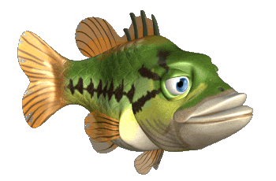
Largemouth bass are one of the most sought-after freshwater gamefish species in America due to their wide native range and accessibility for anglers of all skill levels.
However, understanding bass behavior during different seasons of the year is a major key to successful fishing trips. From chilly winter water temperatures to the heat of summer, here's a basic guide that covers seasonal fishing strategies for largemouth bass.

Slide 3
Summer: Beat the Heat
When summer water temperatures begin to peak, largemouth bass will retreat to cooler, oxygen-rich environments, such as deep water, shady cover, or submerged vegetation. The best time to fish for bass in summer is during the early morning or late evening hours when bass are most active and surface water temperatures are lower.
Some of the best summer bass lures are topwater presentations, such as poppers or soft plastic frogs.

Slide 4
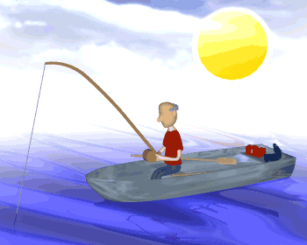
Summer: Beat the Heat
Buzzbaits can also be highly effective on calm mornings or evenings, eliciting explosive strikes.
During the summer daytime hours, shade fishing for bass and locating fish in deeper water will require persistence. Use Carolina rigs, Texas rigs, or deep-diving crankbaits to find bass holding under the shade of cover (vegetation, downed trees, brush piles) or near underwater structure or thermoclines. Pay close attention to water temperature and use your electronics to locate schools of baitfish or submerged cover to greatly bump up your success rates during the dog days of summer.

Slide 5
Fall: Feeding Frenzy
As temperatures begin to cool again, there will be a pre-winter bass feeding frenzy in preparation for the winter months ahead. Mimic the natural forage that is present during the fall season to boost your catch rates. In other words, use lures that imitate shad and other baitfish, like lipless crankbaits, jerkbaits, or swimbaits to trigger bites from hungry bass that are feeding heavily in preparation for the coldest months of the year.

Slide 6
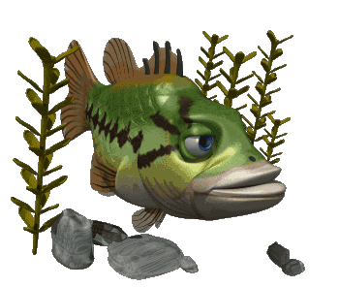
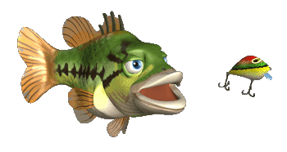
Fall: Feeding Frenzy
If you’re wondering where to find bass in fall, focus your efforts on creekmouths, submerged vegetation, and rocky points – these types of areas typically yield good results. Additionally, as water temperatures drop following the heat of summer, bass become more active and willing to chase down fast-moving presentations. This makes reaction baits like spinnerbaits or chatterbaits effective options as well.

Slide 7
Winter: Cracking the Cold
As air and water temperatures drop, largemouth bass become lethargic and seek refuge in deeper waters. To entice bass into biting during the winter, focus on slow fishing techniques with small profile lures like jigs, spoons, or weedless soft plastics. If you have electronics on your boat, use your fish finder or sonar to find deep structure, like submerged rock piles or ledges – you are likely to find bass in these areas as well.

Slide 8
Winter: Cracking the Cold
Once you locate deep water bass, use a slow retrieve or “deadstick” presentation (keep your bait or lure still) and allow your lures to bounce off the bottom or hover just above it. Slow is always the way to go when bass fishing during the coldest months of the year.

Slide 9
Spring: Spawning Season
The arrival of spring means spawning season for largemouth bass, which triggers a surge in feeding activity as fish migrate into shallow waters to reproduce. Bass will feed aggressively on larger prey items during this period to build up energy reserves. You can capitalize on pre-spawn fishing opportunities by using a variety of lures, including crankbaits, spinnerbaits, and swimbaits, to cover a lot of water quickly and find feeding fish around transitional areas like points, flats, and drop-offs.

Slide 10
Spring: Spawning Season
One of the most important fishing tips to remember when you see bass move up onto their shallow beds to begin the process of spawning is to practice catch and release. Catch and release fishing will help protect vulnerable bass populations and ensure the future health of the fishery.

Slide 11
More Student Angler Series Presentations can be found at southernfishingnews.com.

